Slide 2

Calculating /Specifying Reliability Requirements to Increase Uptime
Ramesh Gulati
Reliability Sherpa

Slide 3
Outline
Safety Minute
Introduction
Knowledge Assessment
Understanding Key Reliability Terms
Calculating / Specifying Reliability
Takeaways / Conclusión

Slide 4

Safety Moment

Slide 5
Safety Minute – Ladder Safety
S
What’s the safest distance of the ladder from the building at the base should be?
  4 feet
  6 feet
  1/5 of ladder’s length
  1/4 of ladder’s working length

Slide 6

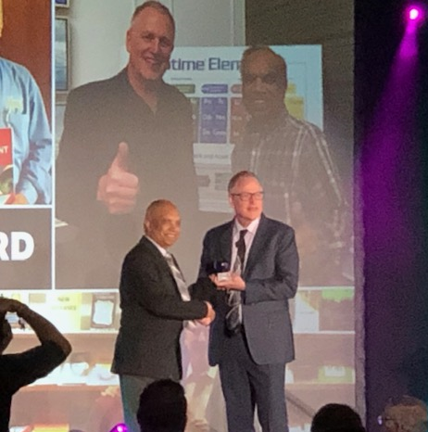
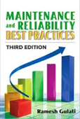

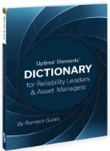

Intro – Me /You
59 plus … years in the industry
  Maintenance & Reliability and Operations Management
  Asset Management – Life Cycle Management
  Process Improvement – Design/Development
  Change Management – Creating a culture of reliability, sustainability & safety
  Certified Professional – PE, CRL, CRE, CMRP, CMRT, CAMA
  Education - BSME, MSIE, MBA
ReliabilityX (2022- )
Jacobs Engineering / AEDC- ATA / Sverdrup (1983-2021)
  Asset Management Group, Tullahoma, TN (2016 -2021)
  AEDC/ATA-Jacobs – Arnold Engineering Development Complex, TN (1983-2016)
    Asset Management & Reliability Planning, Manager
    Reliability/Maintenance/Industrial Engineering Manager
    33 plus years
Before AEDC (1964-1983)
  Carrier A/C (TN)
  True Temper Corp. (Ohio)
  Bethlehem Steel, Burke Steel (NY)
  Heavy Engineering Corp./Foundry Forge Plant
Heavily involved with Industry/Societies
  AMP and IMC/Reliability Web
  SMRP – Society for Maintenance & Reliability Professionals
  Reliability & Maintenance Center (RMC)/UT Knoxville
  IIE/ASQ/NASA – OMFIT/USAF – reliability council
  Member US TAG – PC 251/ISO 55000 Asset Management
  Member US TAG – PC 56/Dependability
Author 5+ books and several articles
Front cover of Uptime Magazine June-July ‘19 issue
Receiving “Lifetime Achievement Award” at The Reliability Conference, Seattle, WA 8 May, 2019
Front cover of – Predictiva21
October 2021

Slide 7
Intro – Me/You
Who – Name
Organization
Role …

Slide 8
The Evolution of Maintenance…Reliability…Asset Mgmt.
4th Generation
Changing Demands
2019 and beyond…
Designing for Reliability – RAMS²O
Culture of Reliability & Safety
Asset and Data Management + IIoT, Industry 4.0
Digital Transformation
Better Understanding
of Equipment Behavior
New Technologies & Practices
3rd Generation
Application of “Best Practices”
Business risk prioritization
Reliability-centered maintenance (RCM)
CBM / PdM
Focus on Reliability
2nd Generation
Planned maintenance
Scheduled Repairs &
Overhauls
CMMS for improved efficiency and control
1st Generation
React to breakdowns
1930 1940 1950 1960 1970 1980 1990 2000 2010 +
RAMS²O= Reliability, Availability, Maintainability, Safety/Sustainability, and Operability
Notes:
This chart shows evolution of maintenance.. From breakdowns / reactive to proactive – implementing best practices.
Now with a better understanding of equipment behavior, and because we know that the majority of equipment failure is not time based, maintenance and reliability organizations must employ mechanisms to predict potential condition based failures. Organizations are now utilizing condition based monitoring technologies and tools like thermography, oil analysis, and vibration. They also need to employ Reliability Systems and comprehensive methodologies like RCM to identify potential failure modes and effects.
The answer is, through the right combination of reliability technologies and best practices.

Slide 9
What is RAMS²O?
R – Reliability
A – Availability
M – Maintainability
S – Safety & Sustainability
O - Operability

Slide 10
Quiz A – Reliability Knowledge Assessment
Best way to improve reliability is with a good maintenance plan
  True
  False
List three “Mean” metrics used often:
  …………………………………
  ………………………………
  …………………………………….
If an asset – pump operated for 100 hours, and it had five failures and it took 10 hours to repair those failures. What is the mean time between failures for this asset?
  10 hours
  5 hours
  20 hours
In the above example – Q 3, what is the mean time to repair?
  10 hours
  5 hours
  2 hours
An asset–motor unit has a reliability of 90% in 10 hours (shift) of operation; what does it mean?
  No failure in a shift
  One failure in a shift
  9 hours of failure-free operation
  10 % chances of a failure
Notes:
10
As it reads.. 8 questions

Slide 11
Reliability ??
What does “Reliability” mean to YOU?
…………………………………………………….
……………………………………………………….
………………………………………………………………..
……………………………………………………………………..

Slide 12
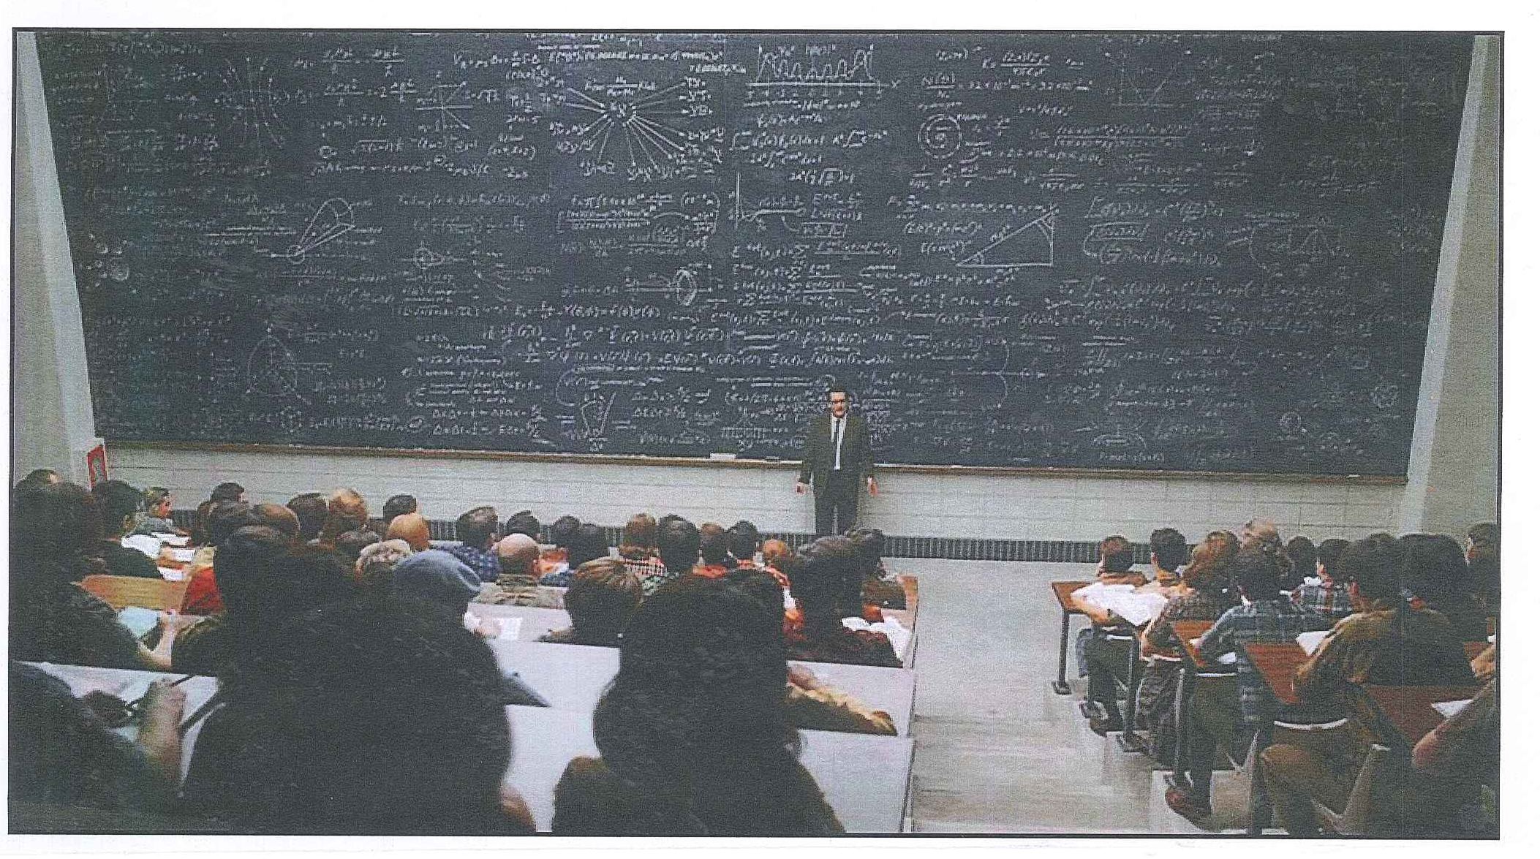
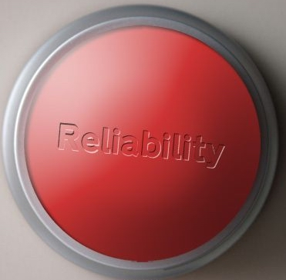
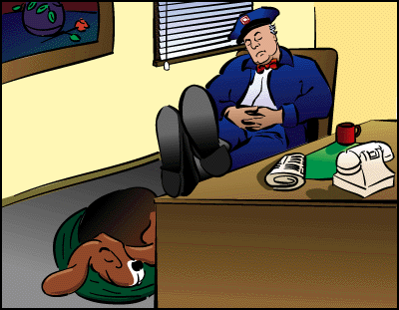
Reliability is …
…a peace of mind.
Press here for more reliability
“and thus, dear students, we have arrived at the formula for reliability…”
Service technician is waiting for a call…

Slide 13
Reliability myth!
How much Reliability do we need?
S
What Percentage of Reliability do we need?
100 %
99 %
90 %
50%
Varies

Slide 14
RAM- Reliability, Availability & Maintainability
Reliability:
----------------------------------------------------------------------
---------------------------------------------------------------------
2) Maintainability:
------------------------------------------------------------------------
------------------------------------------------------------------------
3) Availability:
-------------------------------------------------------------------------------
-------------------------------------------------------------------------------

Slide 15
Who owns Reliability?
Where defects get introduced?
………………….
…………………….
…………………………
……………………………
………………………………
…………………………………..
…………………………………….

Slide 16
Bathtub Curve
Infant
Mortality
Area
Wear Out
Area
Random/Constant
Failure Rate Area
Time

Slide 17



Bathtub Curve – Weibull Life Curve
⟨ 1
(steep fall)
⟩ 1
(steep rise)
Failure Rate
= 1
(flat)
Infant
Mortality
Zone
Design Life
Constant Failure Rate
Wear Out
Zone
Time
The scale parameter, η (eta), defines where the bulk of the distribution lies. The shape parameter, β (beta), defines the shape of the distribution and the location parameter, γ, defines the location of the distribution in time. t is time, a variable. When beta =1, rate is constant and the Weibull distribution equals exponential distribution.
Basically.. Weibull analysis is performed to estimate asset life prediction.

Slide 18

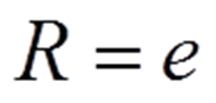

Calculating Reliability
Simplified Reliability formula ( constant failure rate)
OR
*Where

Slide 19

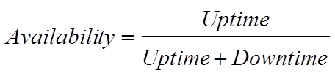
Availability
It is the amount of time in which an asset/machine is able to perform its intended task/function. Availability can also be called 'uptime', and it is one of the key metrics that give insight into production efficiency
Availability is a function of reliability and maintainability
Availability is calculated:
OR

Slide 20
Understanding/Calculating Reliability

Slide 21
Reliability Block Diagram (RBD)
  A system is usually made up of several
  independent components and assets
  which may be connected in series,
  parallel, or a combination configuration
  System Reliability depends on individual
  reliabilities of its components and configuration
  A Reliability Block Diagram (RBD) shows
  logical connections between the system’s assets and components (it is not a schematic showing
  the functional layout)
  Using the RBD, system reliability analysis can be performed by reducing the system to a simple block diagram and using mathematical formulae
RELIABILITY IN SERIES
R₁
R₂
R_{s} = (R₁) (R₂)
RELIABILITY IN PARALLEL
R_{M}
R_{N}
R_{S} = (R_{M} + R_{N}) – (R_{M}) (R_{N})

Slide 22
Assets in Series and Parallel …exercise 6.21
A system consists of four machines (R1, R2, R3 and R4) with Reliabilities of 0.9, 0.8, 0.8 and 0.9 respectively. What would be total system reliability?
R_{sys}
R₁, R₄ = 0.9
R₂, R₃ = 0.8
R₂
R₁
R₄
R₃
.80
.80

Slide 23
Reliability RBD …exercise 6.21

Slide 24
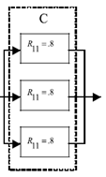
Reliability Modeling
Some failure logic in a Reliability Block Diagram (RBD) includes m – out – of –n that need to function.
m-out-of n configuration
  1 out of 3 = 1 – (1-R)³ = 1 – (1-.8)³ = 0.992
  2 out of 3 = R³ + 3 R² (1-R) = 0.896
  3 out of 3 = R³ = (0.8)³ = 0.512

Slide 25
System Reliability for m-out-of-n Components
S

Slide 26
System Reliability- RBD …. POLL
S
System 1
1.)
A
0.9
B
0.8
C
0.9
System 2
2.)
B₁
0.8
A
0.9
C
0.9
Which system will be more reliable?
1, 2, 3, 4
b) Which system will be more expensive? 1, 2, 3, 4
B₂
0.8
System 3
3.)
A₁
0.9
B₁
0.8
C₁
0.9
A₂
0.9
B₂
0.8
C₂
0.9
System 4
A₁
0.9
B₁
0.8
C₁
0.9
4.)
A₂
0.9
B₂
0.8
C₂
0.9
A₃
0.9
B₃
0.8
C₃
0.9
A₄
0.9
B₄
0.8
C₄
0.9

Slide 27
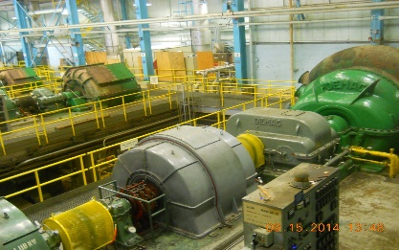
Typical Compressor System Reliability Block Diagram – RBD
X1
W.R. Motor
Gear Drive
Decreases
Sync Motor
Gear Drive
Increases
Compressor
Electrical
Controls
Lube Oil
X1
For t = 16 hours:
or
693 hours
= .9772 = 97.8%
X2
Notes:
This is another block diagram of a typical system.

Slide 28
Calculating Reliability ….. Example 11.1
A plant’s air compressor system operated for 1000 hours last year. The plant’s CMMS system provided the following system data:
  Operating time = 1000 hours
  Number of failures, random = 10
  Total hours of repair time = 50 hours
What is this compressor system's expected reliability and availability if we have to operate this unit for 100 hours or 10 hours?

Slide 29
Exercise 11.1

Slide 30
Calculating Reliability ….. Example 11.2
A plant’s air compressor system is operated for 1000 hours last year. The plant’s CMMS system provided the following system data:
  Operating time = 1000 hours
  Number of failures, random = 10
  Total hours of repair time = 50 hours
What is the expected reliability and availability of this compressor system if we have to operate this unit for 100 hours or 10 hours?
Exercise11.2
What would the MTBF value have to be if the reliability needed was 75% in order to meet customer expectations?
Based on the previously calculated MTBF value, what would the MTTR value have to be if the availability needed was 99% in order to meet customer expectations?

Slide 31
Exercise 11.2

Slide 32
Challenges
Who should pay for Reliability…. Reliability is not free
It takes resources to build reliability … ( RAMS²O) but has a high payout
Evaluate what reliability level you need to satisfy requirements
--- It costs if you got too much or too little
Reliability (RAMS²O) is built during the design/build/installation phase – before the asset is ready to be operated
Get involved early …

Slide 33
Bonus Questions on Reliability – HW/Class:
UW D2 - 106
S
Question #1:
  If an asset is operating at 70 % reliability, what do we need to do to get 90 % reliability? Assume assets will be required to operate for 100 hours.
Question #2:
  Writing specifications/ requirements. Review MRBP 3e textbook, pages 240-241, and write reliability –RAM requirements for a system

Slide 34
Conclusion
Reliability lowers the risk and improves customer satisfaction
Think…Reliability – RAMS²O in early design/build/installation phases
Gather data and evaluate RAM and develop an improvement plan
-- when MTBF = t (operating time), R = 37%
-- R = e ^{-ƛ t} ; ƛ = Lambda is failure rate, t= time
-- Availability is a function of R and M; A= MTBF/(MTBF+MTTR)
Reliability - RAM cannot be improved with just maintenance
-- Maintenance sustain reliability
Reliability lowers the risk with high payout

Slide 35
Exercise # 170111
M&R – AM Words Primer: Connect Words (Left) to Definition (Right)
A standard measurement or reference that forms the basis for comparison
An item or thing with a potential value that an organization owns and has a use for or creates value
An organizational process to maximize value from an asset during its life
A Japanese word for workplace, where value is created
The ability to apply knowledge and skills to achieve intended results.
The difference between the expected value and the actual value
A ranking of assets according to potential operational impact
A condition that causes deviation from design or expected performance and leads to failure
The identification of a nonconformance and its removal
A change from one way of thinking to another
Any resource whose capacity is less than the demand placed on it
A new, positive name of maintenance
Asset
Asset Management
Benchmark
Capacity Assurance
Competence
Criticality
Defect
Defect Elimination
Gemba
Paradigm Shift
Variance
Bottleneck

Slide 36
Ramesh Gulati …
Reliability Sherpa
Ramesh.gulati@ ReliabilityX.com

