Slide 1
Reliability Centered Maintenance (RCM)
A Case Study for FMEA, Criticality, and Task Selection
Nancy Regan
RCM Practitioner

Slide 2
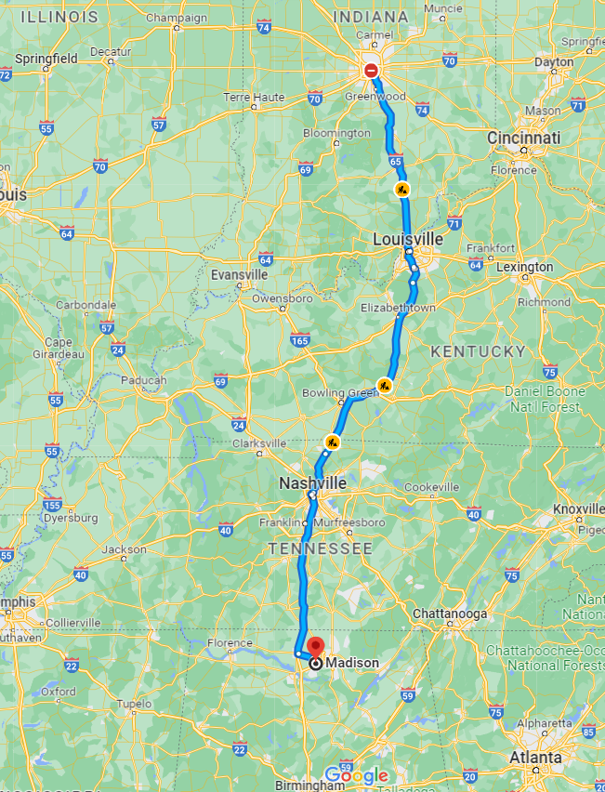
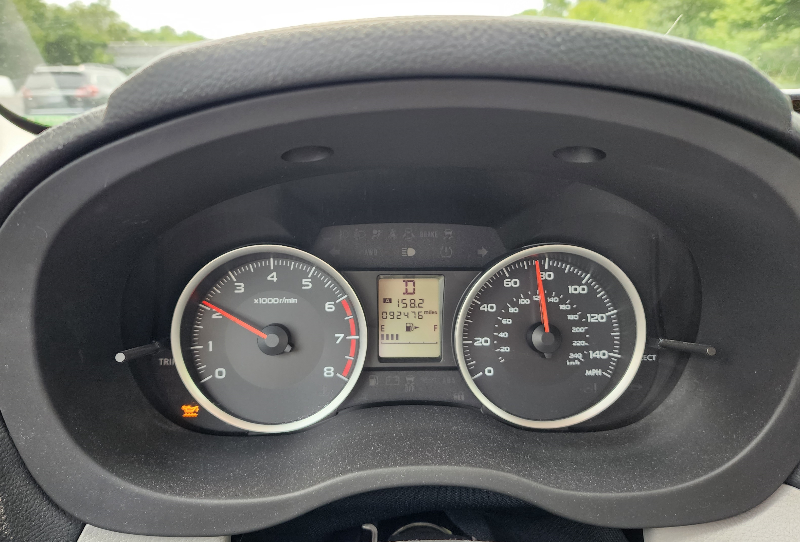
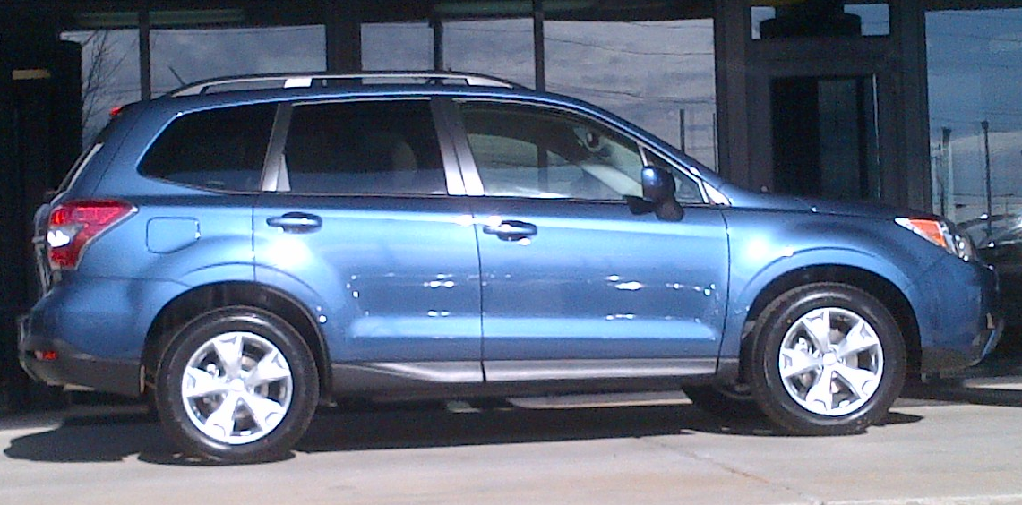
Case Study
2014 Subaru Forester Low Engine Oil Light
2 hours from home

Slide 3
Workshop Agenda
Goal: Understand SAE-JA1011 Compliant RCM
Real-World (personal!) Case Study
Build an FMEA for 4 Failure Modes (scope!)
Assess Consequences
Use RCM Logic to establish a CBM task
NOT a comprehensive introduction to RCM. It is an overview of some key RCM concepts.
You WILL leave understanding what “True” RCM is.

Slide 4
Reliability Centered Maintenance (RCM) Overview

Slide 5
Operating Context Excerpt
2014 Subaru Forester – personal use vehicle. (I drive it almost exclusively.)
Drive approximately 12,000 miles per year in the Southeastern United States (almost entirely in Alabama). Longest journey ~ 4 hours from home.
I do have a “backup” car – 2004 Toyota Corolla.
Scope of analysis is limited to Failure Modes that result in illumination of the Low Engine Oil Light and the “Low Engine Oil Light system” itself.
2.5-liter horizontally opposed four-cylinder (boxer) engine, 170 horsepower.
Low Engine Oil Light illuminates in the event that the engine oil decreases to the lower limit (2 quarts low).
Case Study
2014 Subaru Forester Low Engine Oil Light
2 hours from home

Slide 6
Reliability Centered Maintenance
RCM is a zero-based process used to identify the Failure Management Strategies that are required to ensure an asset meets its mission requirements in its operational environment in the most safe and cost effective manner.
RCM Process
1. Functions
2. Functional Failures
3. Failure Modes
4. Failure Effects
5. Failure Consequences
6. Proactive Maintenance and Intervals
7. Default Strategies

Slide 7
Reliability Centered Maintenance
RCM is a zero-based process used to identify the Failure Management Strategies that are required to ensure an asset meets its mission requirements in its operational environment in the most safe and cost effective manner.
RCM Process
1. Functions
2. Functional Failures
3. Failure Modes
4. Failure Effects
5. Failure Consequences
6. Proactive Maintenance and Intervals
7. Default Strategies
“Reliability”
Include Primary & Secondary Functions

Slide 8
Primary Function: My 2014 Subaru Forester
Performance Standard(s)
Operating Context
To
+
Verb
+
Object
+
+
X
RCM Process
1. Functions
2. Functional Failures
3. Failure Modes
4. Failure Effects
5. Failure Consequences
6. Proactive Maintenance and Intervals
7. Default Strategies
To get from “Point A” to “Point B.”

Slide 9
Primary Function: My 2014 Subaru Forester
Performance Standard(s)
Operating Context
To
+
Verb
+
Object
+
+
Verb | Transport
Object | Up to 5 adult passengers and 3 medium-size suitcases
Performance Standards | Along paved roads and highways Go up to 360 miles without stopping In climates that range from 0º to 115º F (-17º to 46º C) While protecting passengers from the elements
Operating Context | As required

Slide 10
Primary Function: My 2014 Subaru Forester
Performance Standard(s)
Operating Context
To
+
Verb
+
Object
+
+
Verb | Transport
Object | Up to 5 adult passengers and 3 medium-size suitcases
Performance Standards | Along paved roads and highways Go up to 360 miles without stopping In climates that range from 0º to 115º F (-17º to 46º C) While protecting passengers from the elements
Operating Context | As required

Slide 11
Primary Function: My 2014 Subaru Forester
Performance Standard(s)
Operating Context
To
+
Verb
+
Object
+
+
Verb | Transport
Object | Up to 5 adult passengers and 3 medium-size suitcases
Performance Standards | Along paved roads and highways Go up to 360 miles without stopping In climates that range from 0º to 115º F (-17º to 46º C) While protecting passengers from the elements
Operating Context | As required

Slide 12
Primary Function: My 2014 Subaru Forester
Performance Standard(s)
Operating Context
To
+
Verb
+
Object
+
+
Verb | Transport
Object | Up to 5 adult passengers and 3 medium-size suitcases
Performance Standards | Along paved roads and highways Go up to 360 miles without stopping In climates that range from 0º to 115º F (-17º to 46º C) While protecting passengers from the elements
Operating Context | As required

Slide 13
Primary Function: My 2014 Subaru Forester
Performance Standard(s)
Operating Context
To
+
Verb
+
Object
+
+
Verb | Transport
Object | Up to 5 adult passengers and 3 medium-size suitcases
Performance Standards | Along paved roads and highways Drive up to 360 miles without stopping In climates that range from 0º to 115º F (-17º to 46º C) While protecting passengers from the elements
Operating Context | As required

Slide 14
Primary Function: My 2014 Subaru Forester
Performance Standard(s)
Operating Context
To
+
Verb
+
Object
+
+
Verb | Transport
Object | Up to 5 adult passengers and 3 medium-size suitcases
Performance Standards | Along paved roads and highways Drive up to 360 miles without stopping In climates that range from 0º to 115º F (-17º to 46º C) While protecting passengers from the elements
Operating Context | As required

Slide 15
Primary Function: My 2014 Subaru Forester
Performance Standard(s)
Operating Context
To
+
Verb
+
Object
+
+
Verb | Transport
Object | Up to 5 adult passengers and 3 medium-size suitcases
Performance Standards | Along paved roads and highways Drive up to 360 miles without stopping In climates that range from 0º to 115º F (-17º to 46º C) While protecting passengers from the elements
Operating Context | As required

Slide 16
Primary Function: My 2014 Subaru Forester
Performance Standard(s)
Operating Context
To
+
Verb
+
Object
+
+
Verb | Transport
Object | Up to 5 adult passengers and 3 medium-size suitcases
Performance Standards | Along paved roads and highways Drive up to 360 miles without stopping In climates that range from 0º to 115º F (-17º to 46º C) While protecting passengers from the elements
Operating Context | As required
To transport up to 5 adult passengers and 3 medium-size suitcases along paved roads and highways for up to 360 miles without stopping in climates that range from 0º to 115º F (-17º to 46º C) while protecting passengers from the elements.

Slide 17
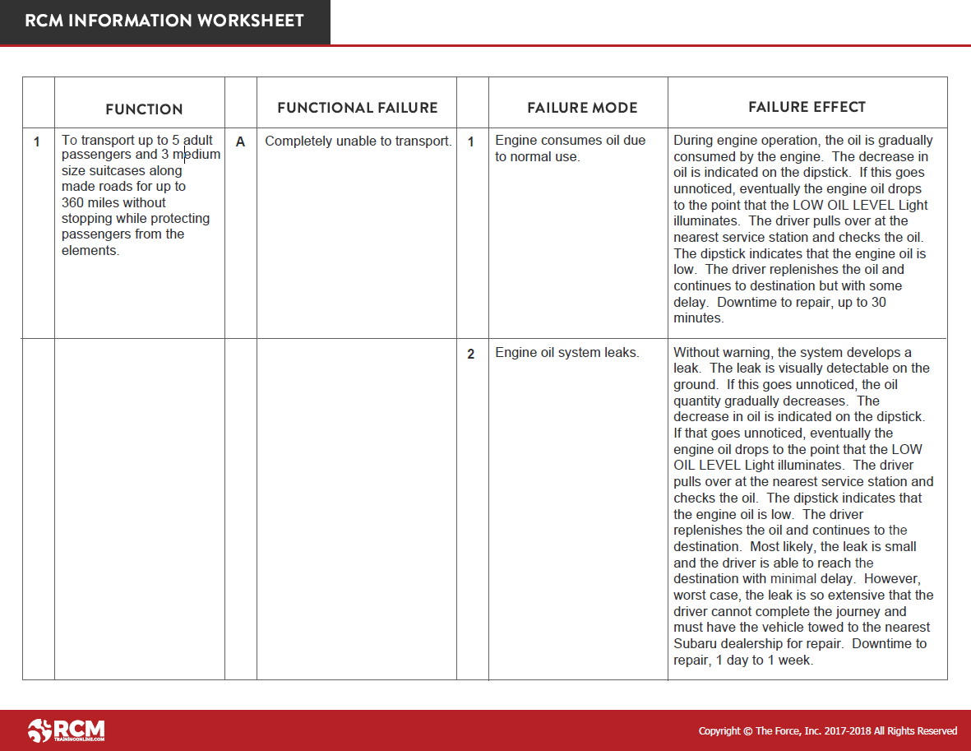
Failure Modes and Effects Analysis (FMEA)
To transport up to 5 adult passengers and 3 medium-size suitcases along paved roads and highways for up to 360 miles without stopping in climates that range from 0º to 115º F (-17º to 46º C) while protecting passengers from the elements.
, as required.
To transport up to 5 adult passengers and 3 medium-size suitcases along paved roads and highways for up to 360 miles without stopping in climates that range from 0º to 115º F (-17º to 46º C) while protecting passengers from the elements.
Copyright © The Force, Inc. 2017-2023 All Rights Reserved

Slide 18
Failure Modes and Effects Analysis (FMEA)
To transport up to 5 adult passengers and 3 medium-size suitcases along paved roads and highways for up to 360 miles without stopping in climates that range from 0º to 115º F (-17º to 46º C) while protecting passengers from the elements.
, as required.
2
Continue listing Secondary Functions.
3
4
… And so on
Copyright © The Force, Inc. 2017-2023 All Rights Reserved

Slide 19
Evident and Hidden Functions

Slide 20
Classifying Functions: Evident
Evident Function
Failure of the Function becomes evident to the operating crew under normal conditions.

Slide 21
Primary Function: My 2014 Subaru Forester
Performance Standard(s)
Operating Context
To
+
Verb
+
Object
+
+
Verb | Transport
Object | Up to 5 adult passengers and 3 medium-size suitcases
Performance Standards | Along paved roads and highways Go up to 360 miles without stopping In climates that range from 0º to 115º F (-17º to 46º C) While protecting passengers from the elements
Operating Context | As required
Evident
Function
To transport up to 5 adult passengers and 3 medium-size suitcases along paved roads and highways for up to 360 miles without stopping in climates that range from 0º to 115º F (-17º to 46º C) while protecting passengers from the elements.

Slide 22
Classifying Functions: Hidden
Hidden Function
Hidden Functions are almost always Protective Devices
Failure of the Function is not evident to the operating crew under normal conditions.

Slide 23
Protective Devices and Hidden Failures
Protective Device:
Device or System intended to protect in the event that another failure occurs.
Notes:
It was born out of extraordinary circumstance.

Slide 24
Hidden Functions
Home Smoke Detector
Sound an audible alarm in the event there is a fire in the room
Protective Device
Hidden Function
Failure of the Function is not evident to the operating crew under normal conditions.
No fire
(normal condition)
+
Smoke detector fails

Slide 25
Hidden Functions
Home Smoke Detector
Sound an audible alarm in the event there is a fire in the room
Protective Device
There IS a fire in the room
(failure condition)
+
Smoke detector fails
=
Multiple Failure

Slide 26
Case Study
2014 Subaru Forester Low Engine Oil Light
What is the Function?
To be capable of visually alerting the driver in the event that the engine oil level decreases to the low level limit. (LOW OIL LEVEL Light)

Slide 27
Case Study
2014 Subaru Forester Low Engine Oil Light
What is the Multiple Failure?
Oil in the reservoir falls to the low level limit
Low Engine Oil Light “system” is failed.

Slide 28
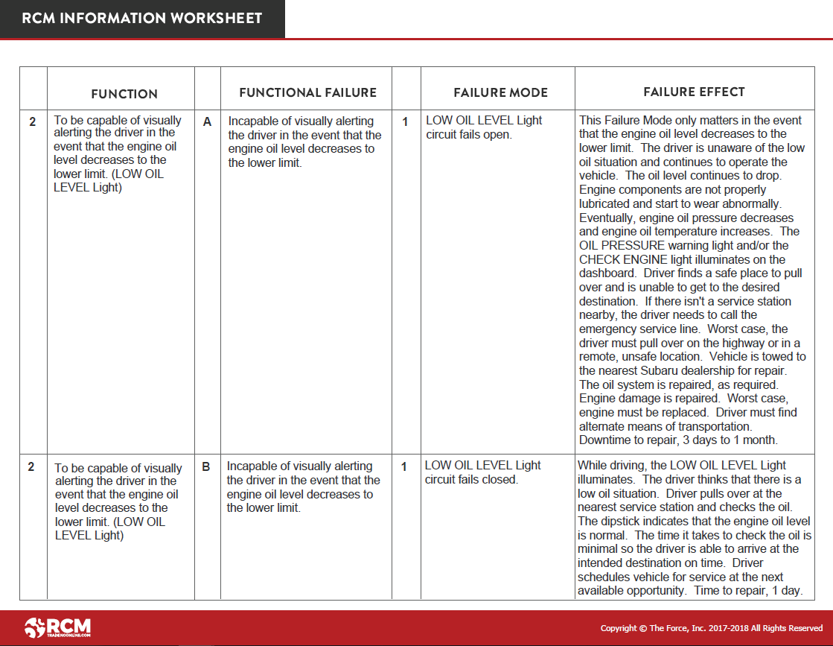
Failure Modes and Effects Analysis (FMEA)
Hidden
Function
To be capable of visually alerting the driver in the event that the engine oil level decreases to the lower limit (LOW OIL LEVEL Light)
Is this an Evident or Hidden Function?
To be capable of visually alerting the driver in the event that the engine oil level decreases to the lower level limit. (LOW OIL LEVEL Light)

Slide 29
Reliability Centered Maintenance
RCM is a zero-based process used to identify the Failure Management Strategies that are required to ensure an asset meets its mission requirements in its operational environment in the most safe and cost effective manner.
RCM Process
1. Functions
2. Functional Failures
3. Failure Modes
4. Failure Effects
5. Failure Consequences
6. Proactive Maintenance and Intervals
7. Default Strategies
Total Failure
Partial Failure

Slide 30
Failure Modes and Effects Analysis (FMEA)
To transport up to 5 adult passengers and 3 medium-size suitcases along paved roads and highways for up to 360 miles without stopping in climates that range from 0º to 115º F (-17º to 46º C) while protecting passengers from the elements.
What is Total Failure?
, as required.
To transport up to 5 adult passengers and 3 medium-size suitcases along paved roads and highways for up to 360 miles without stopping in climates that range from 0º to 115º F (-17º to 46º C) while protecting passengers from the elements.
Copyright © The Force, Inc. 2017-2023 All Rights Reserved

Slide 31
Failure Modes and Effects Analysis (FMEA)
To transport up to 5 adult passengers and 3 medium-size suitcases along paved roads and highways for up to 360 miles without stopping in climates that range from 0º to 115º F (-17º to 46º C) while protecting passengers from the elements.
Total Failure
, as required.
Completely unable to transport.
Copyright © The Force, Inc. 2017-2023 All Rights Reserved

Slide 32
Failure Modes and Effects Analysis (FMEA)
To be capable of visually alerting the driver in the event that the engine oil level decreases to the lower limit (LOW OIL LEVEL Light)
What is Total Failure?
To be capable of visually alerting the driver in the event that the engine oil level decreases to the lower level limit. (LOW OIL LEVEL Light)

Slide 33
Failure Modes and Effects Analysis (FMEA)
To be capable of visually alerting the driver in the event that the engine oil level decreases to the lower limit (LOW OIL LEVEL Light)
Total Failure
Incapable of visually alerting the driver in the event that the engine oil level decreases to the lower limit.
To be capable of visually alerting the driver in the event that the engine oil level decreases to the lower level limit. (LOW OIL LEVEL Light)

Slide 34
Failure Modes and Effects Analysis (FMEA)
To be capable of visually alerting the driver in the event that the engine oil level decreases to the lower limit (LOW OIL LEVEL Light)
How else can it fail?
To be capable of visually alerting the driver in the event that the engine oil level decreases to the lower level limit. (LOW OIL LEVEL Light)

Slide 35
Failure Modes and Effects Analysis (FMEA)
To be capable of visually alerting the driver in the event that the engine oil level decreases to the lower limit (LOW OIL LEVEL Light)
Falsely illuminates the LOW OIL LEVEL Light.
Falsely illuminates the LOW OIL LEVEL Light.

Slide 36
Reliability Centered Maintenance
RCM is a zero-based process used to identify the Failure Management Strategies that are required to ensure an asset meets its mission requirements in its operational environment in the most safe and cost effective manner.
We manage assets at the Failure Mode level.
RCM Process
1. Functions
2. Functional Failures
3. Failure Modes
4. Failure Effects
5. Failure Consequences
6. Proactive Maintenance and Intervals
7. Default Strategies
What specifically causes failure
We proactively identify what could cause each Functional Failure, and then use the remaining four steps of the RCM process to figure out what (if anything at all) we should do to manage it.

Slide 37
Failure Modes
Destination:
Failure Management Strategies
Proactive Maintenance
and
Default Strategies
Failure Mode
A properly written Failure Mode puts you on the right road and sends you in the right direction.

Slide 38
Potential Products of an RCM Analysis
Proactive Maintenance Plan
New/Modifications to Operating Procedures
Failure Finding tasks
RCM Can Yield
Updates/Additions to Technical Publications
Troubleshooting Procedures
New/Modifications to Training Programs
Supply Changes
Equipment Redesigns

Slide 39
How to Compose Failure Modes
Noun
+
Verb
+
(as necessary) Operating Context
Intercooler tubes corrode
Brake pads wear
Compressor disc fatigues
Alternator belt deteriorates
Power turbine blade fatigues

Slide 40
How to Compose Failure Modes
Noun
+
Verb
+
(as necessary) Operating Context
Intercooler tubes corrode
Brake pads wear
Compressor disc fatigues
Alternator belt deteriorates
Power turbine blade fatigues
due to normal use
due to normal use
due to normal use
due to normal use
due to normal use

Slide 41
How to Compose Failure Modes
Noun
+
Verb
+
(as necessary) Operating Context
Hydraulic line chafes
Hydraulic line chafes
due to normal equipment vibration
due to improper routing
Oil filter clogs
Oil filter clogs
due to normal use
due to gearbox break-in
Foreign object enters aircraft engine air inlet
Foreign objects accumulate in aircraft engine inlet
during flight
while on the ground,
with engine off

Slide 42
Why Including Operating Context in Failure Modes Matters
Destination:
Failure Management Strategies
Proactive Maintenance
and
Default Strategies
Failure Mode

Slide 43
Why Operating Context Matters in Failure Modes
Failure Modes with operating context in italics
Failure Management Strategies
Hydraulic line chafes due to normal equipment vibration.
Visually inspect hydraulic line every 25 hours of operation.
Hydraulic line chafes due to improper routing.
Augment training program so that hydraulic lines are routed properly.

Slide 44
Why Operating Context Matters in Failure Modes
Failure Modes with operating context in italics
Failure Management Strategies
Hydraulic line chafes due to normal equipment vibration.
Visually inspect hydraulic line every 25 hours of operation.
Hydraulic line chafes due to improper routing.
Augment training program so that hydraulic lines are routed properly.
Oil filter clogs due to normal use
Change the oil filter after every 500 hours of operation.
Oil filter clogs due to gearbox break-in
Change the oil filter after the first 50 hours of operation.

Slide 45
Why Operating Context Matters in Failure Modes
Failure Modes with operating context in italics
Failure Management Strategies
Hydraulic line chafes due to normal equipment vibration.
Visually inspect hydraulic line every 25 hours of operation.
Hydraulic line chafes due to improper routing.
Augment training program so that hydraulic lines are routed properly.
Oil filter clogs due to normal use
Change the oil filter after every 500 hours of operation.
Oil filter clogs due to gearbox break-in
Change the oil filter after the first 50 hours of operation.
Foreign object enters engine air inlet during flight.
Formulate emergency procedure for an in-flight engine failure.
Foreign object accumulates in engine inlet while aircraft is on the ground with the engine not running.
Inspect the engine inlet for foreign objects prior to engine start.

Slide 46
Why Operating Context Matters in Failure Modes
Failure Modes with operating context in italics
Failure Management Strategies
Hydraulic line chafes due to normal equipment vibration.
Visually inspect hydraulic line every 25 hours of operation. Replace, as required.
Hydraulic line chafes due to improper routing.
Augment training program so that hydraulic lines are routed properly.

Slide 47
Case Study
2014 Subaru Forester Low Engine Oil Light
What specifically could cause (Failure Modes) the engine oil to drop to the low level limit and illuminate the LOW OIL LEVEL Light?
2 hours from home

Slide 48
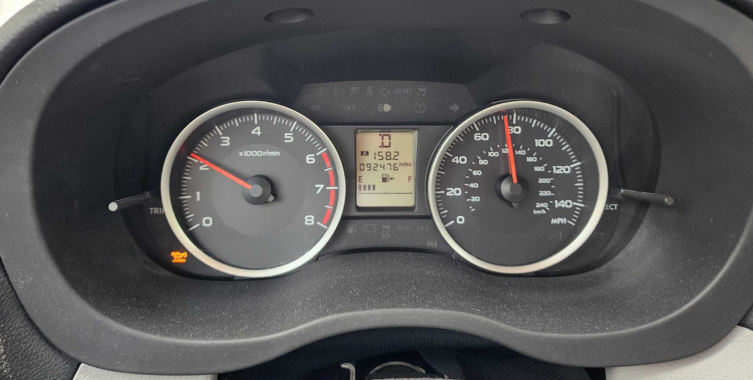
What specifically could cause the engine oil to drop to the low level limit and illuminate the LOW OIL LEVEL LIGHT?
1
2
3
The light could illuminate because the oil level is low due to “normal consumption.” In that case, I had enough oil to make it home without damaging my engine because I only had another 150 miles to go. But, it wouldn’t be wise to continue driving without checking the oil level to ensure I avoid any possible engine damage.
The light could illuminate because the oil level was low due to a leak in the oil system. That’s the worst-case-scenario. Low oil level leads to inadequate lubrication which could cause serious internal damage to engine components and possibly leave me stranded on the side of the road.
The light could falsely illuminate due to a faulty circuit (meaning the engine oil level is normal but the light illuminates anyway). If that is the case, there is nothing I can do about it until I bring my car in for service. But between now and then, my engine will be just fine (assuming I don’t also have a low oil situation in the meantime!)
Failure Modes
Failure Effects
Failure Consequences
Failure Management Strategies

Slide 49
Reliability Centered Maintenance
Failure Effect
A story of what would happen if nothing were done to predict, prevent, or manage its associated Failure Mode.
RCM Process
1. Functions
2. Functional Failures
3. Failure Modes
4. Failure Effects
5. Failure Consequences
6. Proactive Maintenance and Intervals
7. Default Strategies
Important Points
Document worst-case-scenario
Write in enough detail to assess consequences

Slide 50
Failure Effects Include:
A description of the failure process from the occurrence of the Failure Mode to the Functional Failure
Physical evidence that the failure has occurred
How it adversely affects safety and/or the environment
How it affects operational capability/mission
Specific operating restrictions as a result of the failure
Secondary damage
What must be done and how long it takes to repair the failure

Slide 51
Failure Modes and Effects Analysis (FMEA)
To transport up to 5 adult passengers and 3 medium-size suitcases along paved roads and highways for up to 360 miles without stopping in climates that range from 0º to 115º F (-17º to 46º C) while protecting passengers from the elements.
1. Engine consumes oil due to normal use.
, as required.
Copyright © The Force, Inc. 2017-2023 All Rights Reserved

Slide 52
Failure Modes and Effects Analysis (FMEA)
To transport up to 5 adult passengers and 3 medium-size suitcases along paved roads and highways for up to 360 miles without stopping in climates that range from 0º to 115º F (-17º to 46º C) while protecting passengers from the elements.
Note: The Failure Mode is recorded under “Total Failure” because the light “imposes operating restrictions as a result of the failure.”
, as required.
Engine consumes oil due to normal use.
During engine operation, the oil is gradually consumed by the engine. The decrease in oil is indicated on the dipstick. If this goes unnoticed, eventually the engine oil drops to the point that the LOW OIL LEVEL Light illuminates. The driver pulls over at the nearest service station and checks the oil. The dipstick indicates that the engine oil is low. The driver replenishes the oil and continues to the destination but with some delay. Downtime to repair, up to 30 minutes.
Copyright © The Force, Inc. 2017-2023 All Rights Reserved

Slide 53
Failure Modes and Effects Analysis (FMEA)
To be capable of visually alerting the driver in the event that the engine oil level decreases to the lower limit. (LOW OIL LEVEL light)
Copyright © The Force, Inc. 2017-2023 All Rights Reserved

Slide 54
Failure Modes and Effects Analysis (FMEA)
?
What specifically causes…?
Incapable of visually alerting the driver in the event that the engine oil level decreases to the lower limit.
To be capable of visually alerting the driver in the event that the engine oil level decreases to the lower limit. (LOW OIL LEVEL light)
Copyright © The Force, Inc. 2017-2023 All Rights Reserved

Slide 55
Failure Modes and Effects Analysis (FMEA)
LOW OIL LEVEL Light circuit fails open.
Incapable of visually alerting the driver in the event that the engine oil level decreases to the lower limit.
To be capable of visually alerting the driver in the event that the engine oil level decreases to the lower limit. (LOW OIL LEVEL light)
Copyright © The Force, Inc. 2017-2023 All Rights Reserved

Slide 56
Failure Modes and Effects Analysis (FMEA)
LOW OIL LEVEL LIGHT circuit fails open.
This Failure Mode only matters in the event that the engine oil level decreases to the lower limit. The driver is unaware of the low oil situation and continues to operate the vehicle. The oil level continues to drop. Engine components are not properly lubricated and start to wear abnormally. Eventually, engine oil pressure decreases and engine oil temperature increases. The OIL PRESSURE warning light and/or the CHECK ENGINE light illuminates on the dashboard. Driver must pull over and cannot get to the desired destination on time. It is likely driver can find a safe place to pull over and call a tow truck. However, worst case, driver must pull over on a busy highway or on a dark country road at night. The oil system is repaired, as required. Any secondary engine damage is repaired, as required. Worst case, engine must be replaced. Downtime to repair, 3 days to 1 month at a cost ranging from $1,000 to $8,000.
Copyright © The Force, Inc. 2017-2023 All Rights Reserved

Slide 57
Reliability Centered Maintenance
RCM is a zero-based process used to identify the Failure Management Strategies that are required to ensure an asset meets its mission requirements in its operational environment in the most safe and cost effective manner.
RCM Process
1. Functions
2. Functional Failures
3. Failure Modes
4. Failure Effects
5. Failure Consequences
6. Proactive Maintenance and Intervals
7. Default Strategies
Safety
Environmental
Operational
Non-Operational

Slide 58
Reliability Centered Maintenance
RCM is a zero-based process used to identify the Failure Management Strategies that are required to ensure an asset meets its mission requirements in its operational environment in the most safe and cost effective manner.
Figure out how to manage each Failure Mode
RCM Process
1. Functions
2. Functional Failures
3. Failure Modes
4. Failure Effects
5. Failure Consequences
6. Proactive Maintenance and Intervals
7. Default Strategies
Proactive Maintenance
Scheduled Restoration
Scheduled Discard
Condition Based Maintenance
Also known as:
On-Condition Maintenance
Predictive Maintenance (PdM)

Slide 59
RCM Decision Diagram

Slide 60
RCM Decision Diagram
YES
Without inspection, will the loss of Function caused by this Failure Mode become Evident during normal situations?
NO
Safety
Environ- mental
Operational
Non- Operational
Environ- mental
Non- Operational
NO
NO
NO
Safety
Operational
NO
NO
NO
YES
YES
YES
YES
YES
YES
YES
YES
CBM
CBM
CBM
CBM
CBM
CBM
Yes
Yes
Yes
Yes
Yes
Yes
Assign
Assign
Assign
Assign
Assign
Assign
EVIDENT SIDE
HIDDEN SIDE
No
DS?
No
DS?
No
DS?
No
DS?
No
DS?
No
DS?
Restoration
Restoration
Restoration
Restoration
Restoration
Restoration
Yes
Yes
Yes
Yes
Yes
Yes
Assign
Assign
Assign
Assign
Assign
Assign
No
DS?
No
DS?
No
DS?
No
DS?
No
DS?
No
DS?
Replacement
Replacement
Replacement
Replacement
Replacement
Replacement
Yes
Yes
Yes
Yes
Yes
Yes
Assign
Assign
Assign
Assign
Assign
Assign
No
DS?
No
DS?
No
DS?
No
DS?
No
DS?
No
DS?
Default Strategy!
Default Strategy?
Default Strategy?
Default Strategy!
Default Strategy?
Default Strategy?

Slide 61
RCM Decision Diagram
YES
Without inspection, will the loss of Function caused by this Failure Mode become Evident during normal situations?
NO
EVIDENT SIDE
HIDDEN SIDE

Slide 62
RCM Decision Diagram
YES
Without inspection, will the loss of Function caused by this Failure Mode become Evident during normal situations?
NO
Safety
Environ- mental
Operational
Non- Operational
Environ- mental
Non- Operational
NO
NO
NO
Safety
Operational
NO
NO
NO
YES
YES
YES
YES
YES
YES
YES
YES
EVIDENT SIDE
RCM Process
1. Functions
2. Functional Failures
3. Failure Modes
4. Failure Effects
5. Failure Consequences
6. Proactive Maintenance and Intervals
7. Default Strategies
HIDDEN SIDE
Safety
Environmental
Operational
Non-Operational

Slide 63
RCM Decision Diagram
YES
Without inspection, will the loss of Function caused by this Failure Mode become Evident during normal situations?
NO
Safety
Environ- mental
Operational
Non- Operational
Environ- mental
Non- Operational
NO
NO
NO
Safety
Operational
NO
NO
NO
YES
YES
YES
YES
YES
YES
YES
YES
CBM
CBM
CBM
CBM
CBM
CBM
Yes
Yes
Yes
Yes
Yes
Yes
Assign
Assign
Assign
Assign
Assign
Assign
EVIDENT SIDE
HIDDEN SIDE
No
DS?
No
DS?
No
DS?
No
DS?
No
DS?
No
DS?
Restoration
Restoration
Restoration
Restoration
Restoration
Restoration
Yes
Yes
Yes
Yes
Yes
Yes
Assign
Assign
Assign
Assign
Assign
Assign
No
DS?
No
DS?
No
DS?
No
DS?
No
DS?
No
DS?
Replacement
Replacement
Replacement
Replacement
Replacement
Replacement
Yes
Yes
Yes
Yes
Yes
Yes
Assign
Assign
Assign
Assign
Assign
Assign
No
DS?
No
DS?
No
DS?
No
DS?
No
DS?
No
DS?
Default Strategy!
Default Strategy?
Default Strategy?
Default Strategy!
Default Strategy?
Default Strategy?

Slide 64
RCM Decision Diagram
Proactive Tasks Must be Technically Feasible AND Worth Doing in order to assign them.
YES
Without inspection, will the loss of Function caused by this Failure Mode become Evident during normal situations?
Safety
Environ- mental
Operational
Non- Operational
Environ- mental
Non- Operational
NO
NO
NO
Safety
Operational
NO
NO
NO
YES
YES
YES
YES
YES
YES
YES
YES
CBM
CBM
CBM
CBM
CBM
CBM
Yes
Yes
Yes
Yes
Yes
Yes
Assign
Assign
Assign
Assign
Assign
Assign
EVIDENT SIDE
HIDDEN SIDE
No
DS?
No
DS?
No
DS?
No
DS?
No
DS?
No
DS?
Restoration
Restoration
Restoration
Restoration
Restoration
Restoration
Yes
Yes
Yes
Yes
Yes
Yes
Assign
Assign
Assign
Assign
Assign
Assign
No
DS?
No
DS?
No
DS?
No
DS?
No
DS?
No
DS?
Replacement
Replacement
Replacement
Replacement
Replacement
Replacement
Yes
Yes
Yes
Yes
Yes
Yes
Assign
Assign
Assign
Assign
Assign
Assign
No
DS?
No
DS?
No
DS?
No
DS?
No
DS?
No
DS?
Default Strategy!
Default Strategy?
Default Strategy?
Default Strategy!
Default Strategy?
Default Strategy?

Slide 65
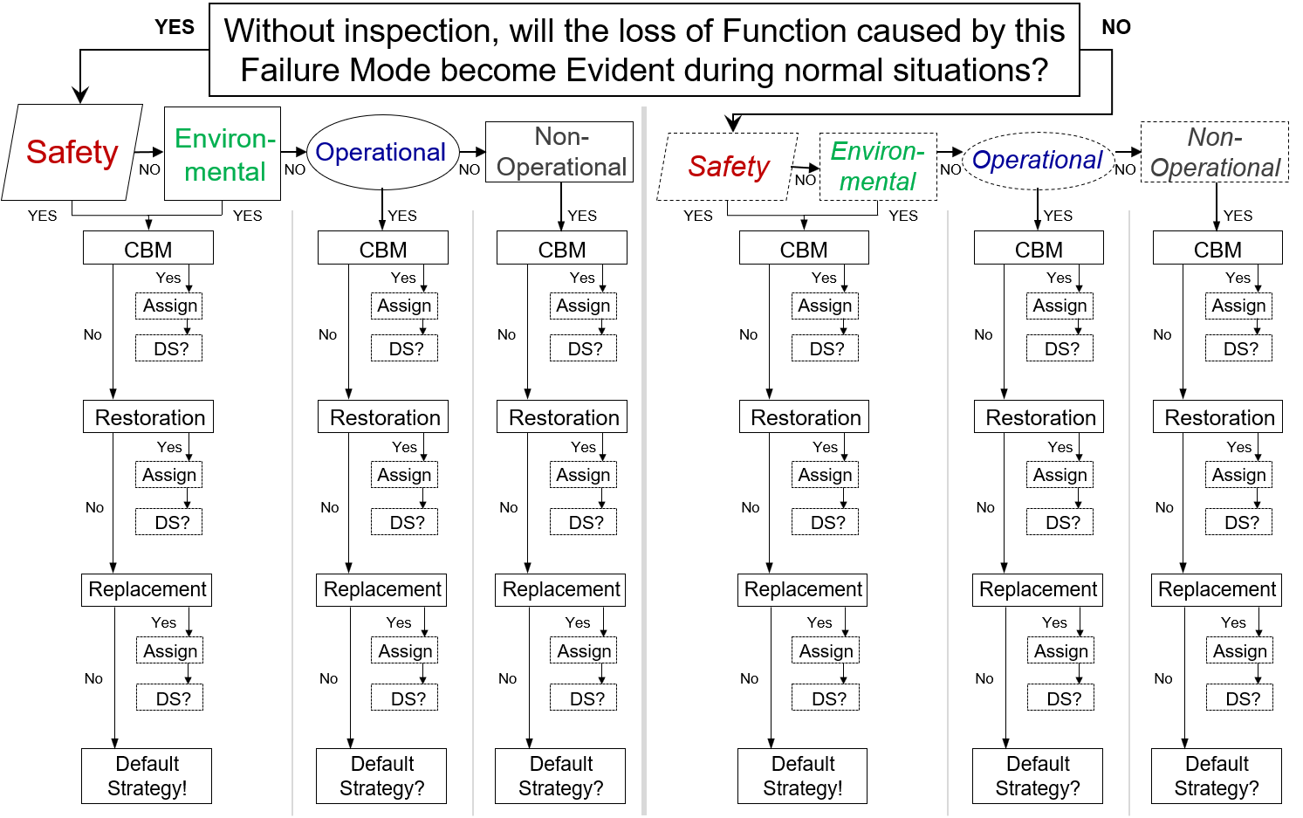
Apply the RCM Decision Diagram
To transport up to 5 adult passengers and 3 medium-size suitcases along paved roads and highways for up to 360 miles without stopping in climates that range from 0º to 115º F (-17º to 46º C) while protecting passengers from the elements.
Copyright © The Force, Inc. 2017-2023 All Rights Reserved
Falsely illuminates the LOW OIL LEVEL Light.
Copyright © The Force, Inc. 2017-2023 All Rights Reserved

Slide 66
On-Condition Maintenance
An On-Condition task is performed at a defined interval to detect a Potential Failure Condition so that maintenance can be performed before the failure occurs.

Slide 67
On-Condition Maintenance
How can a Potential Failure Condition be detected?
Using relatively simple techniques such as monitoring gauges, measuring brake linings, or feeling for vibration via Human Senses
Employing more technically involved techniques such as thermography, frequency analysis, oil analysis, or thermal imaging
Continuous monitoring with devices installed directly on machinery (e.g. strain gauge, accelerometer, etc.)

Slide 68
Two Criteria to assign a Proactive Maintenance Task
In the context of RCM, in order to assign a
Proactive Maintenance task, two criteria must be satisfied:
1. Technically Appropriate
AND
2. Worth Doing
With respect to an On-Condition task, let’s start with what makes it technically feasible.

Slide 69
Condition Based Maintenance (CBM)
In order to determine if an On-Condition task is technically appropriate, Potential Failure Conditions must be evaluated.

Slide 70
Condition Based Maintenance (CBM)
P-F Curve
Resistance to Failure
Time

Slide 71
Condition Based Maintenance (CBM)
P-F Curve
New component Installed


P: Potential Failure Condition:
Resistance to Failure

Time
F: Failure
P-F Interval

Slide 72
Condition Based Maintenance (CBM)
P-F Curve
New V-Belt Installed


P: Potential Failure Condition:
Visual evidence of cuts and frays
Resistance to Failure

Time
F: Failure
P-F Interval
Belt breaks

Slide 73
Condition Based Maintenance (CBM)
P-F Curve
New V-Belt Installed


P: Potential Failure Condition:
Visual evidence of cuts and frays
Resistance to Failure

Time
F: Failure
6 months
Belt breaks

Slide 74
Condition Based Maintenance (CBM)
P-F Curve
New V-Belt Installed
Belt is inspected just before visual evidence of wear is visually detectable


P: Potential Failure Condition:
Visual evidence of cuts and frays
Resistance to Failure

Time
F: Failure
6 months
Belt breaks

Slide 75
Condition Based Maintenance (CBM)
POINT: It doesn’t matter how often the failure occurs. What matters is how quickly failure occurs once the Potential Failure Condition is detectable.
P-F Curve
New V-Belt Installed
Belt is inspected just before visual evidence of wear is visually detectable


P: Potential Failure Condition:
Visual evidence of cuts and frays

The visual evidence of wear is detected on the next inspection, 3 months later
Resistance to Failure
Minimum time remaining to do something about it…to take action to manage the consequences of failure…

Time
3 months
F: Failure
6 months
Belt breaks

Slide 76
Condition Based Maintenance (CBM)
Scenario 1: Asset taken offline yearly. Can it be monitored at intervals less than the P-F Interval?
P-F Curve
New V-Belt Installed
Belt is inspected just before visual evidence of wear is visually detectable


P: Potential Failure Condition:
Visual evidence of cuts and frays

The visual evidence of wear is detected on the next inspection, 3 months later
Resistance to Failure
Minimum time remaining to do something about it…to take action to manage the consequences of failure…

Time
3 months
F: Failure
6 months
Belt breaks

Slide 77
Condition Based Maintenance (CBM)
P-F Curve
Scenario 2: Asset taken offline every month. Can it be monitored at intervals less than the P-F Interval?
New V-Belt Installed
Belt is inspected just before visual evidence of wear is visually detectable


P: Potential Failure Condition:
Visual evidence of cuts and frays
The visual evidence of wear is detected on the next inspection, 3 months later
Shutdown Schedules…

Resistance to Failure
Minimum time remaining to do something about it…to take action to manage the consequences of failure…

Time
3 months
F: Failure
6 months
Belt breaks

Slide 78
Condition Based Maintenance (CBM)
P-F Curve
Brake Pads Installed


P: Potential Failure Condition:
Brake pads worn to only 1/16” remaining
Resistance to Failure

Time
F: Failure
1 Year
Brake drums damaged

Slide 79
The manner in which On-Condition task intervals are set is a widely misunderstood concept.
Four Key Points:
On-Condition maintenance task intervals are NOT based upon MTBF.
On-Condition maintenance task intervals are NOT based upon the useful life of a component.
On-Condition maintenance task intervals are NOT based upon the criticality of the failure.
On-Condition maintenance task intervals are based upon…

Slide 80
Condition Based Maintenance (CBM)
P-F Curve
How QUICKLY failure occurs once the Potential Failure Condition is detectable.
New component Installed

Achieve maximum useful life of components

P: Potential Failure Condition
Resistance to Failure

Time
P-F Interval
F: Functional Failure

Slide 81
Apply the RCM Decision Diagram
Failure Mode
Engine consumes oil due to normal use.
Failure Effect
During engine operation, the oil is gradually consumed by the engine. The decrease in oil is indicated on the dipstick. If this goes unnoticed, eventually the engine oil drops to the point that the LOW OIL LEVEL Light illuminates (down 2 quarts). The driver pulls over at the nearest service station and checks the oil. The dipstick indicates that the engine oil is low. The driver replenishes the oil and continues to the destination but with some delay. Downtime to repair, up to 30 minutes.

Slide 82
Apply the RCM Decision Diagram
Failure Mode
Engine consumes oil due to normal use.
Failure Effect
During engine operation, the oil is gradually consumed by the engine. The decrease in oil is indicated on the dipstick. If this goes unnoticed, eventually the engine oil drops to the point that the LOW OIL LEVEL Light illuminates (down 2 quarts). The driver pulls over at the nearest service station and checks the oil. The dipstick indicates that the engine oil is low. The driver replenishes the oil and continues to the destination but with some delay. Downtime to repair, up to 30 minutes.

Slide 83
Apply the RCM Decision Diagram
Failure Mode
Engine consumes oil due to normal use.
Failure Effect
During engine operation, the oil is gradually consumed by the engine. The decrease in oil is indicated on the dipstick. If this goes unnoticed, eventually the engine oil drops to the point that the LOW OIL LEVEL Light illuminates (down 2 quarts). The driver pulls over at the nearest service station and checks the oil. The dipstick indicates that the engine oil is low. The driver replenishes the oil and continues to the destination but with some delay. Downtime to repair, up to 30 minutes.

Slide 84
Failure Mode
Engine consumes oil due to normal use.
P-F Curve
Oil is Replaced

Potential Failure Condition

Resistance to Failure

Time
Failure
P-F Interval

Slide 85
Failure Mode
Engine consumes oil due to normal use.
P-F Curve
Oil is Replaced

Potential Failure Condition

Resistance to Failure

Time
Failure
P-F Interval
Copyright The Force, Inc. 2023 All Rights Reserved

Slide 86
Failure Mode
Engine consumes oil due to normal use.
P-F Curve
Oil is Replaced

P: Oil level is 75% to the “low level”

Resistance to Failure

Time
Failure
P-F Interval
Copyright The Force, Inc. 2023 All Rights Reserved

Slide 87
Failure Mode
Engine consumes oil due to normal use.
P-F Curve
Oil is Replaced

P: Oil level is 75% to the “low level”

Resistance to Failure

Time
F: Oil level drops to the “low level”
P-F Interval
Copyright The Force, Inc. 2023 All Rights Reserved

Slide 88
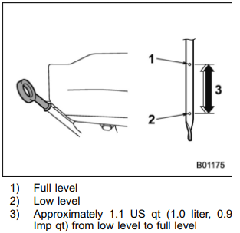
Failure Mode
Engine consumes oil due to normal use.
According to my Subaru Forester manual
Subaru manual states that “consuming more than 1 quart per 1,200 miles” is abnormal.
They recommend checking the engine oil level at each fuel stop.
P-F Curve
Oil is Replaced

P: Oil level is 75% to the “low level”

Resistance to Failure

Time
F: Oil level drops to the “low level”
P-F Interval
Copyright The Force, Inc. 2023 All Rights Reserved

Slide 89
Failure Mode
Engine consumes oil due to normal use.
According to my Subaru Forester manual
<1200 Miles
Subaru manual states that “consuming more than 1 quart per 1,200 miles” is abnormal.
They recommend checking the engine oil level at each fuel stop.
P-F Curve
Oil is Replaced

P: Oil level is 75% to the “low level”

Resistance to Failure

Time
F: Oil level drops to the “low level”
P-F Interval
Copyright The Force, Inc. 2023 All Rights Reserved

Slide 90
Failure Mode
Engine consumes oil due to normal use.
According to my Subaru Forester manual
<1200 Miles
300 miles
300 miles
300 miles
300 miles
Subaru manual states that “consuming more than 1 quart per 1,200 miles” is abnormal.
They recommend checking the engine oil level at each fuel stop.
P-F Curve
Oil is Replaced

P: Oil level is 75% to the “low level”

Resistance to Failure

Time
F: Oil level drops to the “low level”
P-F Interval
Copyright The Force, Inc. 2023 All Rights Reserved

Slide 91
Failure Mode
Engine consumes oil due to normal use.
According to my Subaru Forester manual
<1200 Miles
300 miles
300 miles
300 miles
300 miles
Subaru manual states that “consuming more than 1 quart per 1,200 miles” is abnormal.
They recommend checking the engine oil level at each fuel stop.
P-F Curve
Oil is Replaced

P: Oil level is 75% to the “low level”

Resistance to Failure

Time
900 miles
F: Oil level drops to the “low level”
P-F Interval
Copyright The Force, Inc. 2023 All Rights Reserved

Slide 92
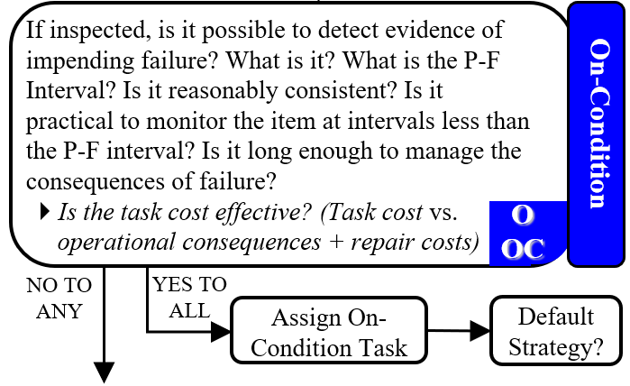
Failure Mode
Engine consumes oil due to normal use.
According to my Subaru Forester manual
<1200 Miles
300 miles
300 miles
300 miles
300 miles
Subaru manual states that “consuming more than 1 quart per 1,200 miles” is abnormal.
They recommend checking the engine oil level at each fuel stop.
P-F Curve
Oil is Replaced

P: Oil level is 75% to the “low level”

Resistance to Failure

Time
900 miles
F: Oil level drops to the “low level”
P-F Interval
Copyright The Force, Inc. 2023 All Rights Reserved

Slide 93
Failure Mode
Engine consumes oil due to normal use.
According to my Subaru Forester manual
<1200 Miles
300 miles
300 miles
300 miles
300 miles
Subaru manual states that “consuming more than 1 quart per 1,200 miles” is abnormal.
They recommend checking the engine oil level at each fuel stop.
P-F Curve
Oil is Replaced

P: Oil level is 75% to the “low level”
How far can I go on one tank of fuel?
16 gallons of fuel x 30 mpg = 480 miles

Resistance to Failure

Time
900 miles
F: Oil level drops to the “low level”
P-F Interval
Copyright The Force, Inc. 2023 All Rights Reserved

Slide 94
Failure Mode
Engine consumes oil due to normal use.
According to my Subaru Forester manual
<1200 Miles
300 miles
300 miles
300 miles
300 miles
Subaru manual states that “consuming more than 1 quart per 1,200 miles” is abnormal.
They recommend checking the engine oil level at each fuel stop.
P-F Curve
Oil is Replaced

P: Oil level is 75% to the “low level”
How far can I go on one tank of fuel?
16 gallons of fuel x 30 mpg = 480 miles

Resistance to Failure
If I check the oil every time I stop for gas, that would be about every 400 miles and that IS practical.

Time
900 miles
F: Oil level drops to the “low level”
P-F Interval
Copyright The Force, Inc. 2023 All Rights Reserved

Slide 95
Apply the RCM Decision Diagram
Failure Mode
Engine consumes oil due to normal use.
Must answer “YES” to ALL questions to assign a task.
Task:
At every fuel stop, check the engine oil level using the dipstick. Replenish the reservoir, as required.

Slide 96
Reliability Centered Maintenance
RCM is a zero-based process used to identify the Failure Management Strategies that are required to ensure an asset meets its mission requirements in its operational environment in the most safe and cost effective manner.
Figure out how to manage each Failure Mode
RCM Process
1. Functions
2. Functional Failures
3. Failure Modes
4. Failure Effects
5. Failure Consequences
6. Proactive Maintenance and Intervals
7. Default Strategies

Slide 97
Potential Products of an RCM Analysis
Proactive Maintenance Plan
New/Modifications to Operating Procedures
Failure Finding tasks
RCM Can Yield
Updates/Additions to Technical Publications
Troubleshooting Procedures
New/Modifications to Training Programs
Supply Changes
Equipment Redesigns

Slide 98
Apply the RCM Decision Diagram
To transport up to 5 adult passengers and 3 medium-size suitcases along paved roads and highways for up to 360 miles without stopping in climates that range from 0º to 115º F (-17º to 46º C) while protecting passengers from the elements.
Copyright © The Force, Inc. 2017-2023 All Rights Reserved
Falsely illuminates the LOW OIL LEVEL Light.
Copyright © The Force, Inc. 2017-2023 All Rights Reserved

Slide 99
Apply the RCM Decision Diagram
This Failure Mode only matters in the event that the engine oil level decreases beyond the lower limit. The driver is unaware of the low oil situation and continues to operate the vehicle. The oil level continues to drop. Engine components are not properly lubricated and start to wear abnormally. Eventually, engine oil pressure decreases and engine oil temperature increases. The OIL PRESSURE warning light and/or the CHECK ENGINE light illuminates on the dashboard. Driver must pull over and cannot get to the desired destination on time. It is likely that the driver can find a safe place to pull over and call a tow truck. However, worst case, driver must pull over on a busy highway or on a dark country road at night. The oil system is repaired, as required. Any secondary engine damage is repaired, as required. Worst case, engine must be replaced. Downtime to repair, 3 days to 1 month at a cost ranging from $1,000 to $8,000.
To be capable of visually alerting the driver in the event that the engine oil level decreases to the lower limit. (LOW OIL LEVEL light)
Incapable of visually alerting the driver in the event that the engine oil level decreases to the lower limit.
Falsely illuminates the LOW OIL LEVEL Light.
LOW OIL LEVEL LIGHT circuit fails open.
Copyright © The Force, Inc. 2017-2023 All Rights Reserved

Slide 100
Apply the RCM Decision Diagram
Failure Mode
LOW OIL LEVEL LIGHT circuit fails open.
Failure Effect
This Failure Mode only matters in the event that the engine oil level decreases to the lower limit. The driver is unaware of the low oil situation and continues to operate the vehicle. The oil level continues to drop. Engine components are not properly lubricated and start to wear abnormally. Eventually, engine oil pressure decreases and engine oil temperature increases. The OIL PRESSURE warning light and/or the CHECK ENGINE light illuminates on the dashboard. Driver must pull over and cannot get to the desired destination on time. It is likely driver can find a safe place to pull over and call a tow truck. However, worst case, driver must pull over on a busy highway or on a dark country road at night. The oil system is repaired, as required. Any secondary engine damage is repaired, as required. Worst case, engine must be replaced. Downtime to repair, 3 days to 1 month at a cost ranging from $1,000 to $8,000.
X
X
X

Slide 101
Reliability Centered Maintenance
RCM Process
1. Functions
2. Functional Failures
3. Failure Modes
4. Failure Effects
5. Failure Consequences
6. Proactive Maintenance and Intervals
7. Default Strategies
Steps 1-4: FMEA
Failure Modes and Effects Analysis
Steps 1-5: FMECA
Failure Modes, Effects,
and Criticality Analysis

Slide 102
Augment Failure Data with a Facilitated Working Group
RCM Analysis Working Group
Need the people managers say “I can’t afford to lose them for a week.”
“Work of art watching alignment.”
Systems Engineer
Operator
OEM
Maintainer
Planner
FACILITATOR

Slide 103
NancyRegan@RCMTrainingOnline.com
Thank You!
NancyReganRCM
RCM Training Online

Slide 105
BACKUP SLIDES ONLY

Slide 106
GOAL: Proactive Maintenance Plan
Destination:
Failure Management Strategies
Proactive Maintenance
and
Default Strategies
Failure Mode
A properly written Failure Mode puts you on the right road and sends you in the right direction.

Slide 107
How detailed should Failure Modes be written?
What specifically causes the diesel engine to fail?
Diesel engine fails
GOAL:
Proactive Maintenance Plan
Engine oil deteriorates due to normal use
Engine oil diminishes due to normal use
Cooling fan drive belt wears due to normal use
Starter motor fails
Visually inspect cooling fan drive belt every 500 operating hours. Replace, as required.
Change the engine oil every 6 months.
Check engine oil level prior to use. Replenish, as required.
No scheduled maintenance

Slide 108
How detailed should Failure Modes be written?
Starter motor fails
GOAL:
Proactive Maintenance Plan
Electrical connections loosen
Armature insulation breaks down
Solenoid fails
Brushes wear
Starter motor fails
Too Much Detail
Plunger sticks
Coil burns out
…and so on…
No scheduled maintenance

Slide 109
Condition Based Maintenance (CBM)
P-F Curve
There can be more than one Potential Failure Condition
Structure is new
P₁: Crack detectable using ultrasonic inspection



P₂: Crack detectable using radiographic x-ray

P₃: Crack detectable using eddy current
Resistance to Failure

P₄: Crack detectable using dye penetrant

P₅: Crack detectable with the human eye

Time
F: Structure fails
P-F Interval

Slide 110
Condition Based Maintenance (CBM)
P-F Curve
There can be more than one “Failure.”
Component installed
P: Corrosion is visually detectable


F₁: More than 5 pits (corrosion control no possible; component must be replaced)

3 months
Resistance to Failure
P-F₁ Interval

Time
F₂: Component fails
2 years
P-F₂ Interval

Slide 111
Proactive Maintenance
Condition Based Maintenance (CBM)
Preventive Maintenance
Scheduled Restoration
Scheduled Replacement
P-F Curve
New V-belt installed

P:
Visual evidence of wear on belt

Wear-Out Region
How QUICKLY Failure Occurs
Conditional Probability of Failure
Useful Life
Resistance to Failure
Constant Failure Probability
Age

Belt breaks
F:
Time
6 months
P-F Interval:

Slide 112
Failure Mode | Function | Functional Failure | Failure Mode | Failure Effect
1A1 | 1. To provide compressed air that is oil free, <95F, at a minimum of 3,500 SCFM, 100 psig output pressure, with a minimum of 5 psig rise to surge to make up this compressor's portion of maintaining 10,500 SCFM and 90 psig header pressure to the plant. | A. Unable to provide compressed air. | 1. Main drive shaft (coupling the motor to the compressor) lubrication dissipates. | Over time, this causes metal to metal contact which causes abnormal wear on the coupling teeth. Eventually, vibration levels increase. May cause excessive stress on the shaft, motor bearing(s), and the bullgear bearings. Vibration levels increase and are indicated on the system tab of the graphic display. Eventually, vibration levels increase such that the high vibration alarm system (from any one of the stages) produces alarm text on the INFO tab of the graphic display and illuminates the TROUBLE INDICATION light. If the text and the light go unnoticed, eventually, the vibration in one or more of the stages increases such that the high vibration trip system produces alarm text on the INFO tab, shuts down the compressor motor, energizes the prelube pump, and illuminates the PRELUBE PUMP RUNNING light. (The TROUBLE INDICATION light remains illuminated.) The inlet valve closes, and the bypass valve opens unloading the compressor. The graphic display indicates that the compressor is down. Possible internal damage to the motor, shaft, and/or the bullgear bearing. This causes low instrument air to the plant. It takes 2 days to replace the coupling but it could take weeks if the motor, shaft, and/or bullgear are damaged. Production stops for up to 2 days while an alternate means of producing instrument air is put in place.

Slide 113
Main drive shaft lubrication dissipates
Over time, this causes metal to metal contact which causes abnormal wear on the coupling teeth. Eventually, vibration levels increase. May cause excessive stress on the shaft, motor bearing(s), and the bullgear bearings. Vibration levels increase and are indicated on the system tab of the graphic display. Eventually, vibration levels increase such that the high vibration alarm system (from any one of the stages) produces alarm text on the INFO tab of the graphic display and illuminates the TROUBLE INDICATION light. If the text and the light go unnoticed, eventually, the vibration in one or more of the stages increases such that the high vibration trip system produces alarm text on the INFO tab, shuts down the compressor motor, energizes the prelube pump, and illuminates the PRELUBE PUMP RUNNING light. (The TROUBLE INDICATION light remains illuminated.) The inlet valve closes, and the bypass valve opens unloading the compressor. The graphic display indicates that the compressor is down. Possible internal damage to the motor, shaft, and/or the bullgear bearing. This causes low instrument air to the plant. It takes 2 days to replace the coupling but it could take weeks if the motor, shaft, and/or bullgear are damaged. Production stops for up to 2 days while an alternate means of producing instrument air is put in place at a cost of $200,000.

Slide 114
Main drive shaft lubrication dissipates
Over time, this causes metal to metal contact which causes abnormal wear on the coupling teeth. Eventually, vibration levels increase. May cause excessive stress on the shaft, motor bearing(s), and the bullgear bearings. Vibration levels increase and are indicated on the system tab of the graphic display. Eventually, vibration levels increase such that the high vibration alarm system (from any one of the stages) produces alarm text on the INFO tab of the graphic display and illuminates the TROUBLE INDICATION light. If the text and the light go unnoticed, eventually, the vibration in one or more of the stages increases such that the high vibration trip system produces alarm text on the INFO tab, shuts down the compressor motor, energizes the prelube pump, and illuminates the PRELUBE PUMP RUNNING light. (The TROUBLE INDICATION light remains illuminated.) The inlet valve closes, and the bypass valve opens unloading the compressor. The graphic display indicates that the compressor is down. Possible internal damage to the motor, shaft, and/or the bullgear bearing. This causes low instrument air to the plant. It takes 2 days to replace the coupling but it could take weeks if the motor, shaft, and/or bullgear are damaged. Production stops for up to 2 days while an alternate means of producing instrument air is put in place at a cost of $200,000.

Slide 115
Main drive shaft lubrication dissipates
Over time, this causes metal to metal contact which causes abnormal wear on the coupling teeth. Eventually, vibration levels increase. May cause excessive stress on the shaft, motor bearing(s), and the bullgear bearings. Vibration levels increase and are indicated on the system tab of the graphic display. Eventually, vibration levels increase such that the high vibration alarm system (from any one of the stages) produces alarm text on the INFO tab of the graphic display and illuminates the TROUBLE INDICATION light. If the text and the light go unnoticed, eventually, the vibration in one or more of the stages increases such that the high vibration trip system produces alarm text on the INFO tab, shuts down the compressor motor, energizes the prelube pump, and illuminates the PRELUBE PUMP RUNNING light. (The TROUBLE INDICATION light remains illuminated.) The inlet valve closes, and the bypass valve opens unloading the compressor. The graphic display indicates that the compressor is down. Possible internal damage to the motor, shaft, and/or the bullgear bearing. This causes low instrument air to the plant. It takes 2 days to replace the coupling but it could take weeks if the motor, shaft, and/or bullgear are damaged. Production stops for up to 2 days while an alternate means of producing instrument air is put in place at a cost of $200,000.

Slide 116
Main drive shaft lubrication dissipates
Over time, this causes metal to metal contact which causes abnormal wear on the coupling teeth. Eventually, vibration levels increase. May cause excessive stress on the shaft, motor bearing(s), and the bullgear bearings. Vibration levels increase and are indicated on the system tab of the graphic display. Eventually, vibration levels increase such that the high vibration alarm system (from any one of the stages) produces alarm text on the INFO tab of the graphic display and illuminates the TROUBLE INDICATION light. If the text and the light go unnoticed, eventually, the vibration in one or more of the stages increases such that the high vibration trip system produces alarm text on the INFO tab, shuts down the compressor motor, energizes the prelube pump, and illuminates the PRELUBE PUMP RUNNING light. (The TROUBLE INDICATION light remains illuminated.) The inlet valve closes, and the bypass valve opens unloading the compressor. The graphic display indicates that the compressor is down. Possible internal damage to the motor, shaft, and/or the bullgear bearing. This causes low instrument air to the plant. It takes 2 days to replace the coupling but it could take weeks if the motor, shaft, and/or bullgear are damaged. Production stops for up to 2 days while an alternate means of producing instrument air is put in place at a cost of $200,000.

Slide 117
Main drive shaft lubrication dissipates
Over time, this causes metal to metal contact which causes abnormal wear on the coupling teeth. Eventually, vibration levels increase. May cause excessive stress on the shaft, motor bearing(s), and the bullgear bearings. Vibration levels increase and are indicated on the system tab of the graphic display. Eventually, vibration levels increase such that the high vibration alarm system (from any one of the stages) produces alarm text on the INFO tab of the graphic display and illuminates the TROUBLE INDICATION light. If the text and the light go unnoticed, eventually, the vibration in one or more of the stages increases such that the high vibration trip system produces alarm text on the INFO tab, shuts down the compressor motor, energizes the prelube pump, and illuminates the PRELUBE PUMP RUNNING light. (The TROUBLE INDICATION light remains illuminated.) The inlet valve closes, and the bypass valve opens unloading the compressor. The graphic display indicates that the compressor is down. Possible internal damage to the motor, shaft, and/or the bullgear bearing. This causes low instrument air to the plant. It takes 2 days to replace the coupling but it could take weeks if the motor, shaft, and/or bullgear are damaged. Production stops for up to 2 days while an alternate means of producing instrument air is put in place at a cost of $200,000.

Slide 118
Failure Modes and Effects Analysis (FMEA)
To transport up to 5 adult passengers and 3 medium-size suitcases along paved roads and highways for up to 360 miles without stopping in climates that range from 0º to 115º F (-17º to 46º C) while protecting passengers from the elements.
, as required.
Engine oil system leaks.
Copyright © The Force, Inc. 2017-2023 All Rights Reserved

Slide 119
Failure Modes and Effects Analysis (FMEA)
Engine oil system leaks.
Without warning, the system develops a leak. The leak is visually detectable on the ground.) If the visual leak goes unnoticed, the oil quantity gradually decreases. The decrease in oil is indicated on the dipstick. If this goes unnoticed, eventually the engine oil drops to the point that the LOW OIL LEVEL Light illuminates. The driver pulls over at the nearest service station and checks the oil. The dipstick indicates that the engine oil is low. The driver replenishes the oil and continues to the destination but with some delay. Most likely, the leak is small and the driver is able to reach the destination with minimal delay. However, worst case, the leak is so extensive that the driver cannot complete the journey. Driver is stuck on the side of the road waiting for a tow truck. Worst case, this is at night on the highway or on a two-lane, dark country road. Downtime to repair, up to two weeks, up to $2,000.

Slide 120
Failure Modes and Effects Analysis (FMEA)
To be capable of visually alerting the driver in the event that the engine oil level decreases to the lower limit. (LOW OIL LEVEL light)
?
What is another Functional Failure?
Copyright © The Force, Inc. 2017-2023 All Rights Reserved

Slide 121
Failure Modes and Effects Analysis (FMEA)
To be capable of visually alerting the driver in the event that the engine oil level decreases to the lower limit. (LOW OIL LEVEL light)
Falsely illuminates the LOW OIL LEVEL Light.
Falsely illuminates the LOW OIL LEVEL Light.
Copyright © The Force, Inc. 2017-2023 All Rights Reserved

Slide 122
Failure Modes and Effects Analysis (FMEA)
Falsely illuminates the LOW OIL LEVEL Light.
Falsely illuminates the LOW OIL LEVEL Light.
?
What specifically causes it to falsely illuminate?
Copyright © The Force, Inc. 2017-2023 All Rights Reserved

Slide 123
Failure Modes and Effects Analysis (FMEA)
Falsely illuminates the LOW OIL LEVEL Light.
LOW OIL LEVEL Light circuit fails closed.
Falsely illuminates the LOW OIL LEVEL Light.
Copyright © The Force, Inc. 2017-2023 All Rights Reserved

Slide 124
Failure Modes and Effects Analysis (FMEA)
While driving, the LOW OIL LEVEL Light illuminates. The driver thinks that there is a low oil situation. Driver pulls over at the nearest service station and checks the oil. The dipstick indicates that the engine oil level is normal. The time it takes to check the oil is minimal so the driver is able to arrive at the intended destination with minimal delay. Driver schedules the vehicle for service at the next available opportunity. Time to repair, up to one day.
Falsely illuminates the LOW OIL LEVEL Light.
LOW OIL LEVEL Light circuit fails closed.
Falsely illuminates the LOW OIL LEVEL Light.
Copyright © The Force, Inc. 2017-2023 All Rights Reserved

