Slide 2


Is maintenance just a cost center?
Where’s the value?
James Reyes-Picknell
Principal Consultant

Slide 3
Published Abstract
As maintainers we know that there is a lot of value in what we do. Without our work, the plant and equipment will soon stand still and our businesses will close. This Compass Session addresses the issue of maintenance from the perspective of the value that we know is being delivered in qualitative terms (it impacts on safety, health, revenue, costs and the company's reputation) , and the difficulties in quantifying it. We all know maintenance can be improved , that we can do things more efficiently, and make machines more reliable , but there's no money for projects. You will learn to demonstrate the savings that are possible when things are done more efficiently, and the additional income that can arise from the investment in the definition of the correct work. You'll also learn how to enlist support to integrate operators and supply chain into the team , to make those changes happen and the benefits realized. This session shows where value is generated and how the roles of operations and supply chain are essential to capturing that value.
Notes:
As maintainers we know there is a lot of value in what we do. Without our work, plant and equipment will soon stop and our companies will then go out of business. What we do impacts on safety, health, revenues, costs and company reputation. A dirty little truth about maintenance is that it is only us who work in it, that really know the value of what we do – or do we?
We do know our value in qualitative terms, but can we quantify it? Most maintenance can be improved and we know it. We can do things more efficiently, and we can keep things running more reliably. We often know how to do that, but when we want to make those improvements there is no money for them. Why?
Most business people know very little about what we do and how it impacts their business. They see maintenance as a repair shop. We fix what breaks. And they know little, or nothing, more. They may know that maintenance represents a significant cost, and they may even know that they can’t get away with cutting it too much. But they do not know the full value of what maintenance can deliver, nor what it takes to deliver it.
If you want to make improvements you need a decision maker, someone with executive level authority, to back you up. To get that, you will need explain what value you can deliver, and in terms they can understand. You will need to show them the savings that are possible from doing things more efficiently,

Slide 4
What are we spending on maintenance?
5 to 40% of non-energy operating costs
Lowest in static infrastructure, highest in heavy mobile equipment
We spend it on:
Labor (including overtime)
Materials (usually close to 50/50 ratio with labor costs) & equipment
Overheads (management, administrative, IT support)
We spend it through:
Our own staff, support equipment, and stores / purchases
Contractor staff, purchases and rental equipment

Slide 5
What do we get for that spending?
Uptime on our productive assets (availability)
Return to service after breakdowns
  Tends to be expensive and disruptive to operations
  Breakdowns happen naturally, through abuse, and through excessive maintenance
  Focus on Work Management will reduce downtime per incident, but won’t reduce incidents
Avoidance of breakdowns through proactive maintenance
  Much less expensive than breakdown work if we do the right proactive maintenance
  Focus on the right maintenance will reduce frequency and severity of breakdowns
Fewer asset related downtime incidents means less disruption to operations, longer run times, and more revenue generation

Slide 6
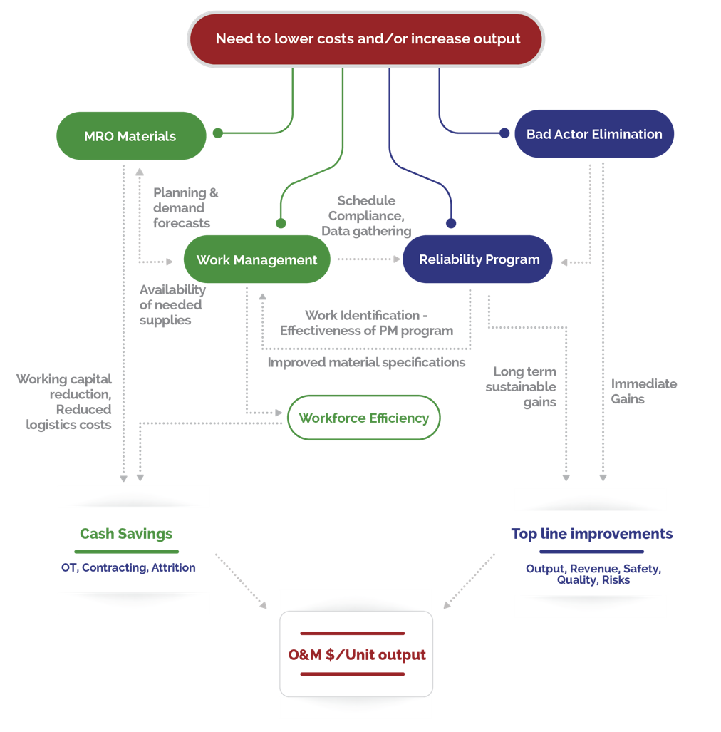
Can we do better?
Efficiency => O&M Costs
Efectiveness => Revenues
Tactical Improvements
Strategic Improvements

Slide 7
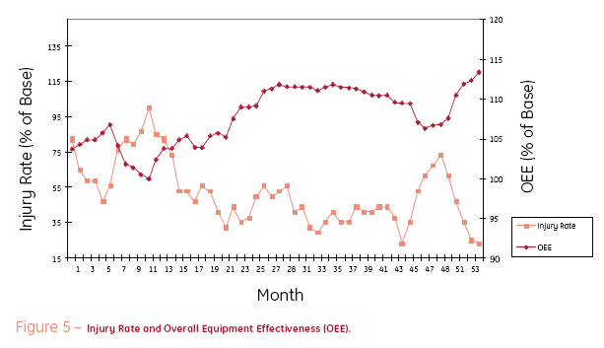
Safety can improve
From: Ron Moore, “Making Common Sense, Common Practice”, May 2004, Elsevier

Slide 8
Other “risks” can be reduced
Reliability improves safety through less exposure to equipment in an abnormal state (failed). Less bad happens if the equipment runs as it should.
Similar risks are also reduced:
Environmental incidents (containment, emissions, energy consumption)
Business loss (less risk to insured and uninsured business losses)
Stock/spare parts outages (greater stability in demand forecasting)
Customer/public image

Slide 9
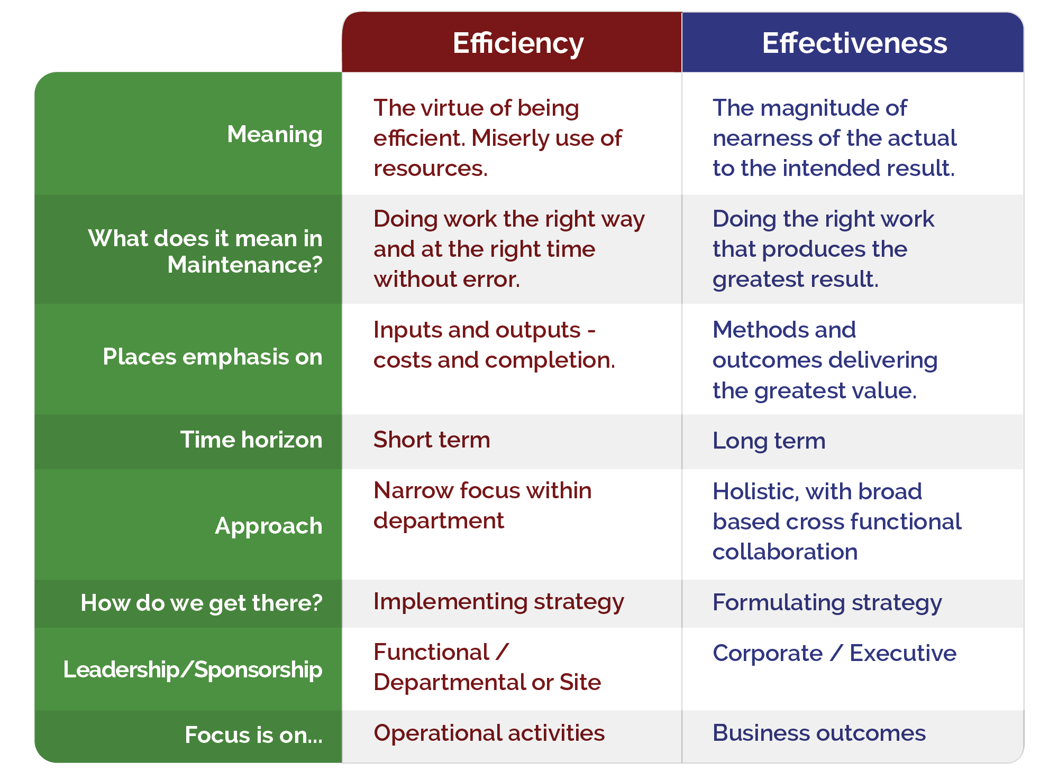
We improve through a deliberate approach

Slide 10
Strategic move towards proactive is the key
Proactive
Precise timing, planning and scheduling
Eliminates serious breakdowns
Reduces impact of most breakdowns
Reduces all risks
Stabilizes availability and production rates (lowers variability)
Lowest cost form of maintenance
Enables maximum revenue generation
Reactive
Surprise timing
Some planning possible but scheduling impossible
Breakdowns normal
Frequent disruption of production (high variability in output)
Increased risks to quality, safety, environment and business
Highest cost form of maintenance
Difficult to forecast revenue
Can harm public image, attract regulatory attention

Slide 11
Proactive shift improves work identification
WM is tactical, but shifting to proactive turns it into a strategic advantage.
Identification of all likely breakdowns is a part of identifying the proactive work that is needed.
This increases ratio of proactive to breakdown substantially.
Since proactive and breakdown (reactive) work are identified both can be planned for.
Proactive can be scheduled.
Reactive will arise randomly, but you can be ready for it.
Maintenance Work Management
Identify
Plan
Schedule
Immediate
Learn
Execute
Assign

Slide 12
Good planning of all work, and process discipline improve productivity
Can almost double “wrench time”

Slide 13
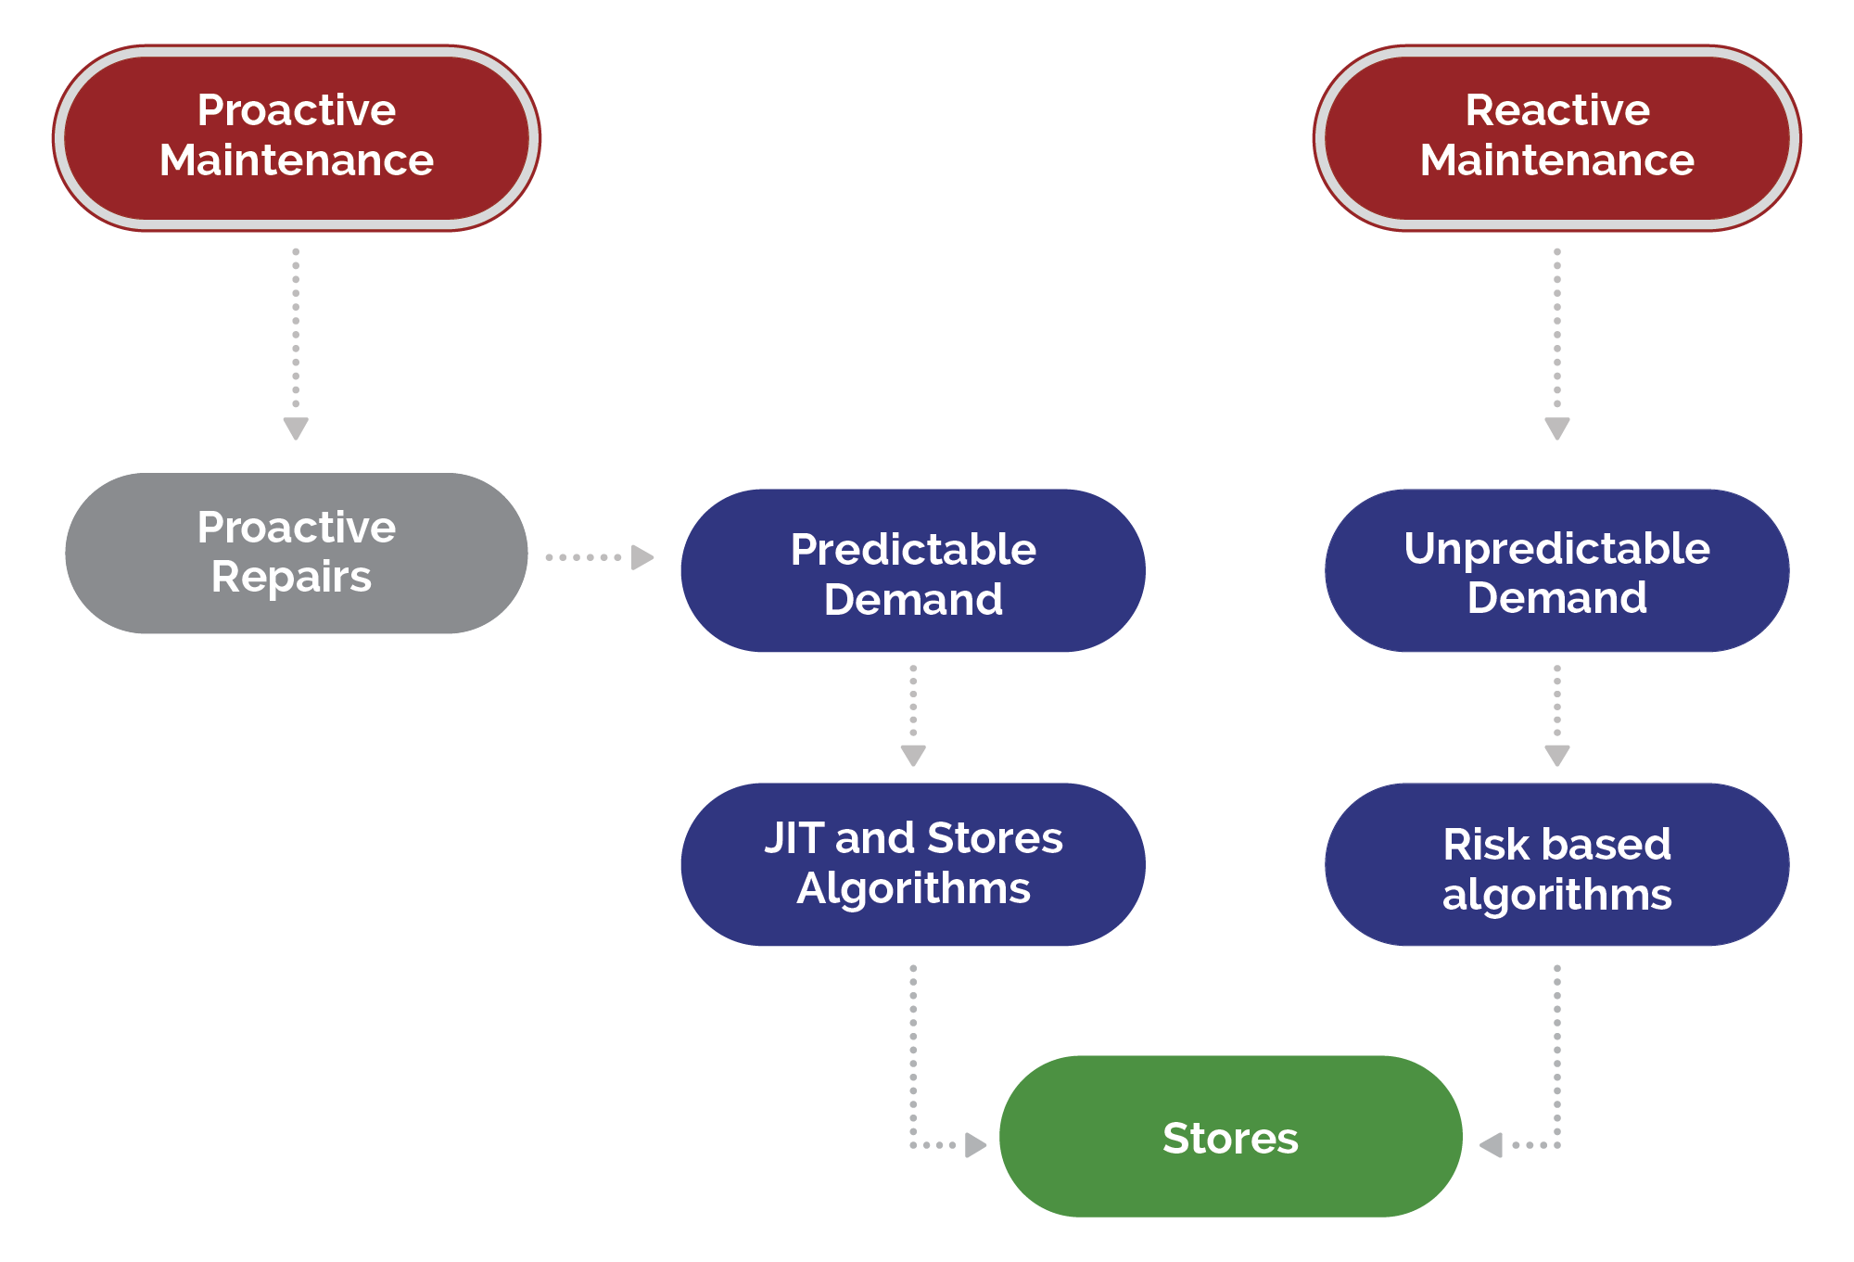
Better planning of more proactive work helps solve the #1 complaint (i.e.: parts)
Proactive approach leads to more predictable demand, lower probability of stock out.
Correct identification of proactive work also results in better understanding of what will breakdown and how. Improves readiness for breakdowns.

Slide 14
Big cost savings are posible (example)
Cost unit assumption
  1 work unit of P&S work = 1 $unit
  1 work unit of unP&unS work = 3 $units
Old Budget = $10 million
  = 20 x 1 $unit + 80 x 3 $units
  = (20 + 80 x 3) x 1 $unit
  $unit = $10 m / 260 units
  = $38,462 / unit
New Budget = 80 x 1 $unit + 20 x 3 $unit
  = (80 + 20 x 3) x $38,462
  = 140 x $38,462 = $5,384,615
Saves $4.62 million
“As is” and “future” states
As is
  20% planned & scheduled
    10% (half) is PM
  80% unplanned & unscheduled
Future (goal)
  80% planned & scheduled
    50% to 60% is PM
    Includes “found” work from PM
  20% unplanned & unscheduled

Slide 15
Revenue gains
Shifting to proactive enables increased availability (uptime).
If your operations can utilize that added availability then production output will increase.
Utilization is often improved with higher availability because there are fewer disruptions.
Rule of thumb: 1% increase in Av means 1% increase in revenue.
Plants: Av > 95% (some like utilities better than 98%)
Fleets: Av > 85% (90% if new)
Discrete manufacturing: Av > 91%
Av (target) - Av (today) x Revenue (today) / 100 = Potential revenue gain

Slide 16
It is achievable
One customer operating 6 (gold) mines (all médium scale operations):
Annual maintenance costs savings were $100 million
Annual potential revenue gain was > $900 million
  That was the equvalent of adding another mine to the company portfolio with NO capital investment required.
Another customer operating 4 (diamond) mines (2 large, 2 small):
First year revenue gain was $600 million
Utilities (elec and gas) upwards of 20% cost savings

Slide 17
James Reyes-Picknell
james@consciousasset.com

