Slide 2
Principles of Maintenance Planning & Scheduling
Doc Palmer PE, MBA, CMRP
Author McGraw-Hill Maintenance Planning and Scheduling Handbook

Slide 3
Principles of Planning & Scheduling
Context
Purpose of Planning & Scheduling
Principles of Planning
Principles of Scheduling
Dealing with Reactive Work
Results

Slide 4
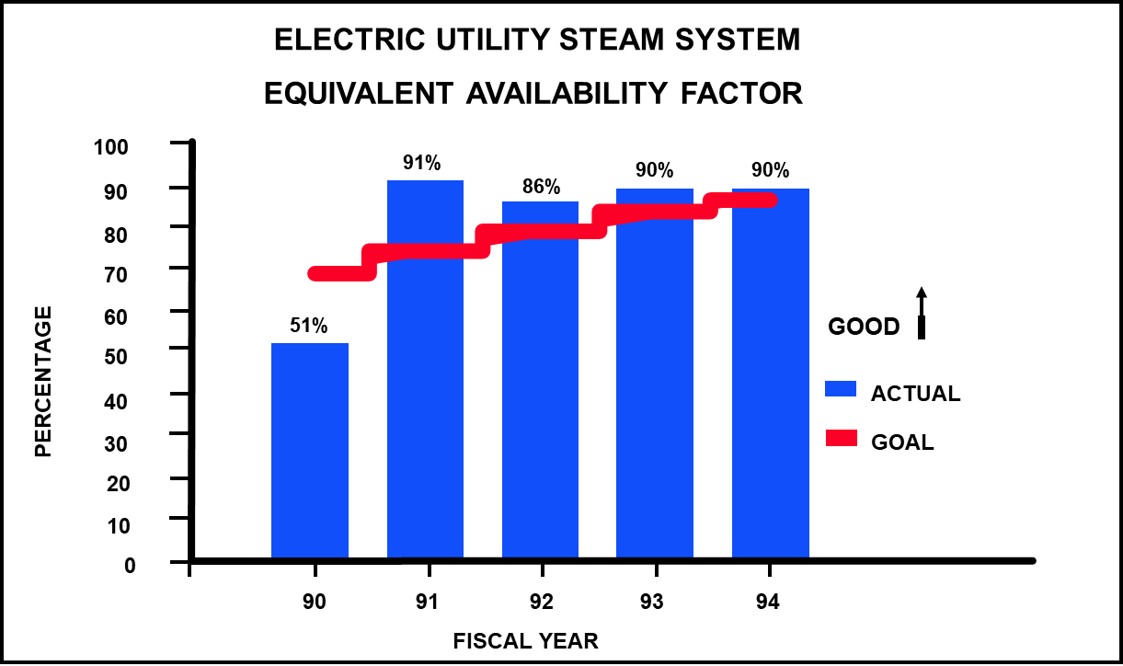
Context: From Bad to Great Is Easier
Typical electric systems operate at about 85% availability
We were so bad, we were allowed to change

Slide 5
Context: P&S Is Not the “Silver Bullet”
You have to deal with all these areas
Leadership
Storeroom
PM
PdM
Project Work
Tools & Tool Room
Shops
Apprenticeship Program
Technician Training
Certification Program
Supervisor Freedom
Scheduling
Planning
Equipment Database
Improve Work Processes

Slide 6
Context: Maintenance vs Fixing Things
“Maintenance” is really things not breaking
Fixing things is easy (reactive work)
See what to fix
Get a pat on the back
Allowed to hire staff
Working on things before they break is not easy (proactive work)
What do you work on?
What do you do?
Who will appreciate what you did?
Not allowed to replace staff
How do we have time to do more proactive work when we have our hands full of reactive work?

Slide 7
Purpose: Most People Think P&S Is
Getting Parts ready
Getting Tools ready
Getting Instructions ready
But this primary focus gives incredible frustration
Planners don’t perfectly identify all the parts and tools
Craftspersons don’t want help with instructions anyway

Slide 8
Purpose: What P&S Really Is
Instead of trying to have all parts, tools, and instructions ready,
the PURPOSE of P&S is to help us complete more work and better work than we would normally complete (that proactive work that we never had time to do)
(Sounds like semantics, doesn’t it?)

Slide 9
Purpose
Properly implemented, planning and scheduling gives
a 50% bump in work order completion rate
“better” plans over the years for a new person guide and a senior person reference
because of wrench time

Slide 10
Purpose: Bump
30 Mechanics Yielding the Effect of 47 Mechanics
(17 Extra Mechanics for free)
137 Craftspersons Yielding the Effect of 215 Craftspersons
(78 Extra Craftspersons for free)
CAUTION: Be careful pushing for productivity. There must be a quality pushback in workforce
Stop

Slide 11
Purpose: Better
Beyond productivity, there is also quality input from P&S
A “better” selection of parts and tools
Helpful instructions you might not remember or know
More proactive work (actually coming from the productivity bump)

Slide 12
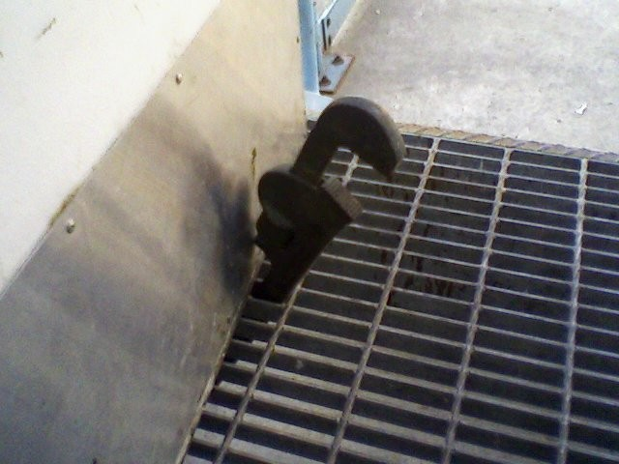
Purpose: Wrench Time Opportunity
Feeling: "Our wrench time is above 80%”
Variations
"But we're always busy working"
"We're working as well as we can”
Reality: Industry average for wrench time is 25 - 35%
Best practice wrench time: 50 to 55%

Slide 13
Purpose: The Leverage of Planning
Three Mechanics without “Planning”
3 X 35% = 105%
One Planner, Two Mechanics
1 X 0% + 2 X 55% = 110%
Ratio Planner to Mechanics 1 : 20 - 30
55% / 35% = 1.57 (57% Improvement)
30 Mechanics X 1.57 = 47 Mechanics

Slide 14
Purpose: The Leverage of Planning
Value in salaries of 17 persons
Presume $75/hr incldg benefits (in 2022)
17 persons X $75/hr X 2080 hr/yr = $2,652,000 per year

Slide 15
Purpose: The Leverage of Planning
$2,652,000 per year
Industry “1:10 Rule” Extra PROACTIVE work is worth 10 times input
(Properly grease instead of replace, collateral damage, lost product)
Value of 1 planner for 30 persons
26,520,000 per year

Slide 16
Planning Principles
Principle 1 Protect planners
Planners not on craft crews
Planners not pulling wrenches
Not doing other stuff

Slide 17
Planning Principles
Principle 2 Focus on future work
Run the Deming Cycle
Don’t help jobs in progress at the expense of planning the new work
Not ‘Planner” but “Craft Historian”
Not “perfect plans” but “growing better plans”
Do Job
Plan
Learn
Feedback

Slide 18
Planning Principles
Principle 3 Save plans at the asset level
Planners personalize information we have learned for each asset
N
0
North Unit #2 Control Valve B Strainer File Created 4/22/XX by Lee
2
F
C
0
0
3

Slide 19
Planning Principles
Principle 4 Simple judgments for time estimates
Get all work through the Deming Cycle and do not bog down
A reasonable time guess (SWAG) is “good enough”
Don’t over-think the time estimates
The time estimates have a wide variance, but a normal distribution (As many run over as under)
They are “good enough” to generally assign work and build schedules

Slide 20
Planning Principles
Principle 5 Plan as much detail as possible, subject to constraint of planning all the work
Get all work through the Deming Cycle and do not bog down
We’d like a great plan as a guide for a new person and reference for a senior person, but there is not enough time to plan each job to that level at the start
Trust the skilled craftspersons to know what to do as we build better plans over the years
Pass work requiring design change to engineers

Slide 21
Planning Principles
Principle 6 If measured, measure wrench time with statistical sampling
You don’t have to measure it
You can’t have people report their own wrench time
You can’t just follow people around
Measuring it doesn’t improve it
Planning work alone doesn’t improve wrench time
That’s why scheduling is needed…

Slide 22
Scheduling Principles
Principle 1 You need job plans
You need the time estimates

Slide 23
Scheduling Principles
Principle 2 You need a credible priority system
Not too simple, not too complicated
At least 4 levels
Now, This Week, Next Week, Longer
I like 5 levels
Now, This Week, Next Week, This Month, Longer
(Emergency, Urgent, Next Week, This Month, Longer)

Slide 24
Scheduling Principles
Principle 3 A week is the right time frame for productivity
Long enough to smooth estimates and provide for bundling of common work
Short enough to provide for a reasonable goal, a sense of mission

Slide 25
Scheduling Principles
Principle 4 Load schedule to 100% of labor capacity
Mostly as a simple “batch” of work
M T W Th F
Fred #15678
Mike #14356
Mike #14682
Mike #19765
Mike #12345
Mike #15983
Jack #13456
Fred #15234
Jack #11123
Jason #18764
Jack #15893
Jason #12356
Mike #15790
Fred #16387
Fred #16222
Fred #13456
Mike #15467
Mike #17865
Jack #14567
Fred #18796
Mike #13458
Jason #15689
Mike #17856
Fred #13478
Mike #13456
Jack #18976
Jason #17689
Jack #15672
Fred #15470
Jason #18395
Jason #12359
Mike #14579
Mike #14567
Jason #13600

Slide 26
Scheduling Principles
Principle 5 Supervisors make the daily schedules
There is too much churn in maintenance to schedule or assign daily work too far in advance

Slide 27
Scheduling Principles
Principle 6 Get schedule compliance between 40 and 90%
Below 40%: ignoring the schedule
Above 90%: not fully loading the schedule 100%
NOT a school grade where 90-100% = “A”

Slide 28
Reactive Work
Plan some of the reactive work
Urgent (but not emergency) work
Check with supervisor first & ONLY plan the ones that the supervisor is not about to start
NEVER tell a supervisor to wait
Allows running the Deming Cycle
You don’t have to make perfect plans
Allows more credible schedules for next week if the urgent ones don’t start after all

Slide 29
Reactive Work
AVOID blanket standing work orders
Blankets make scheduling mushy
(Difficult to load 100%)
Blankets get abused and you lose vital history

Slide 30
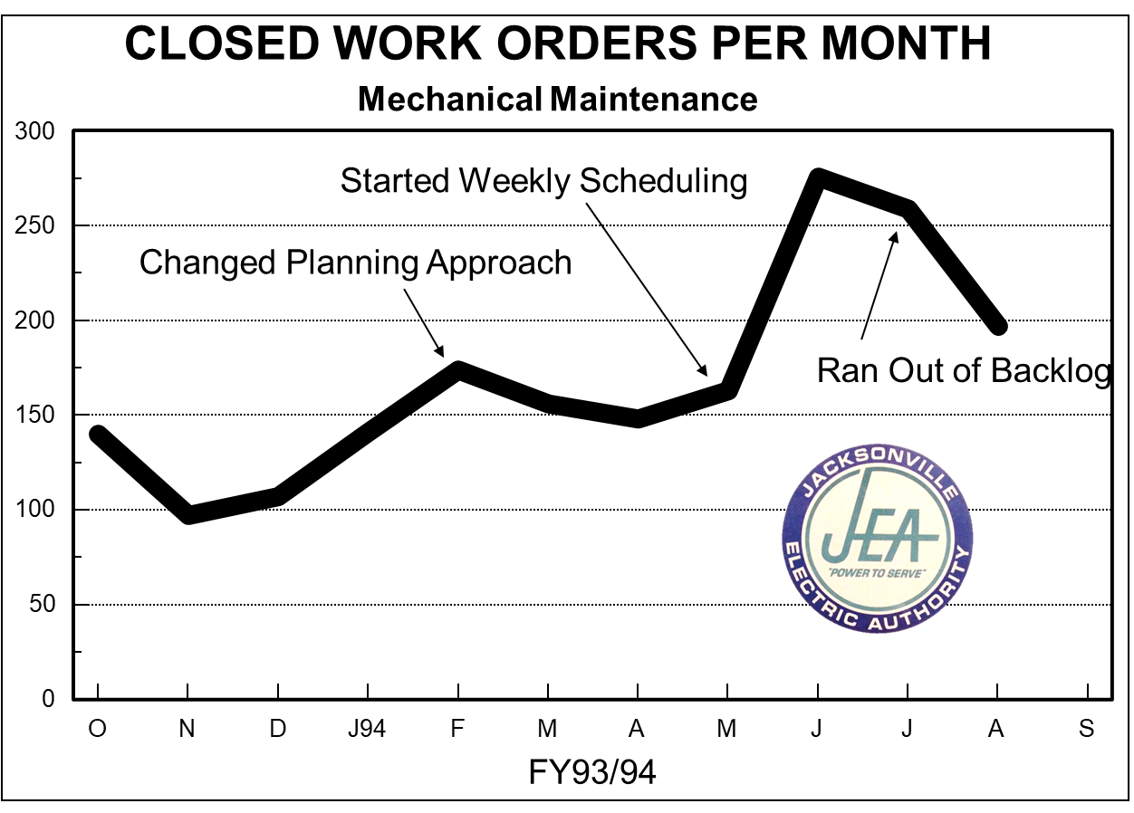
Results: Power Plant

Slide 31
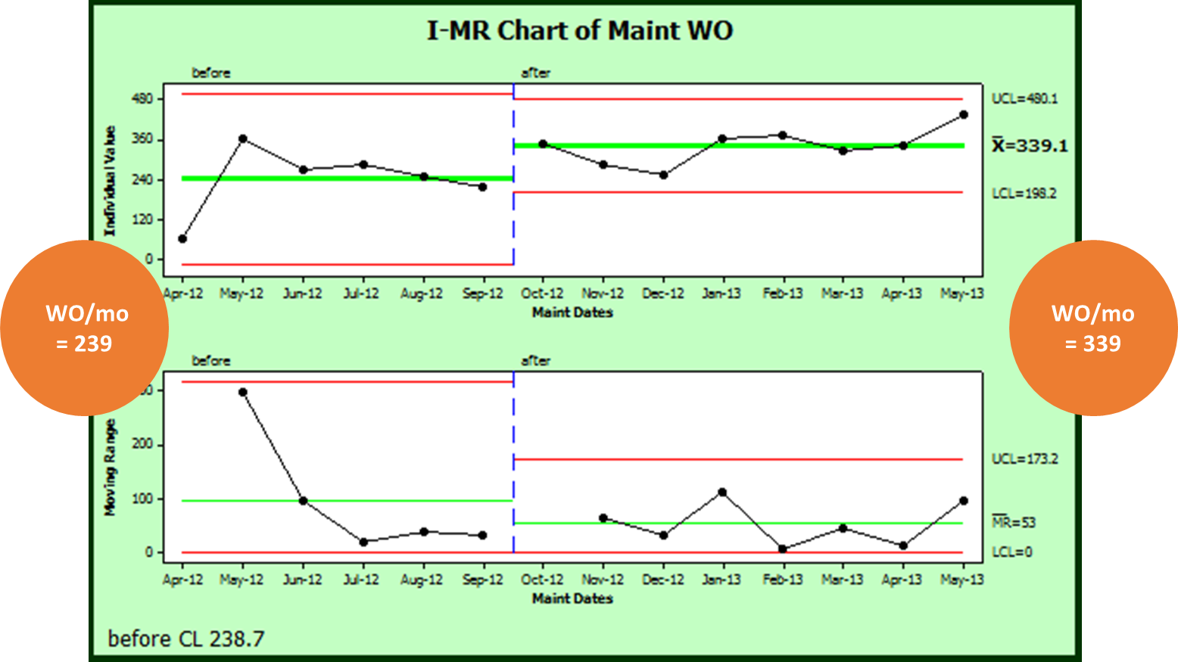
Results: Grain Mill

Slide 32
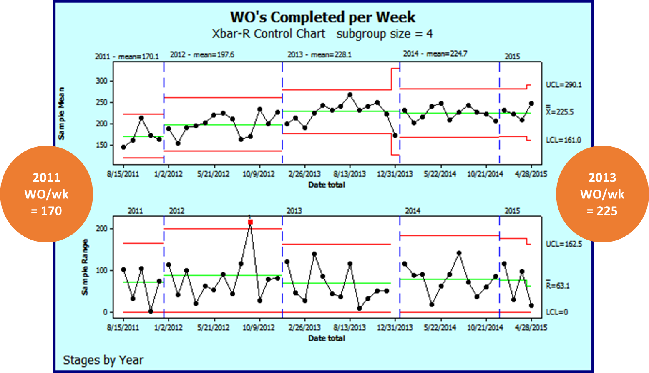
Results: Pulp Mill

Slide 33
Conclusion
The concepts to make planning and scheduling work are unusual:
1 Imperfect plans – Improve over time
2 Fully loaded schedules – It is okay to break
3 Plan some of the reactive work – Never tell a supervisor to wait
That’s why most companies cannot make them work

Slide 34
Conclusion
Don’t settle for being a good plant. Be a great plant!

Slide 35
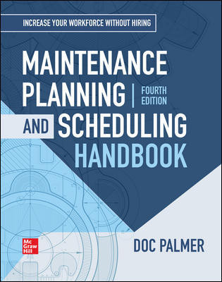
Doc Palmer
docpalmer@palmerplanning.com
www.palmerplanning.com

